Slide 1
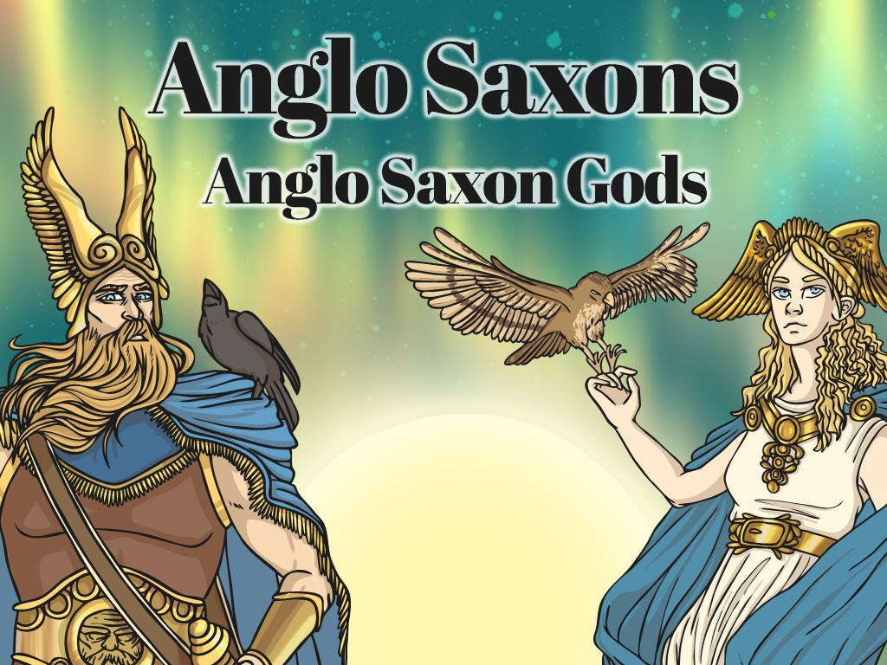

What did Anglo Saxons believe?

Slide 2

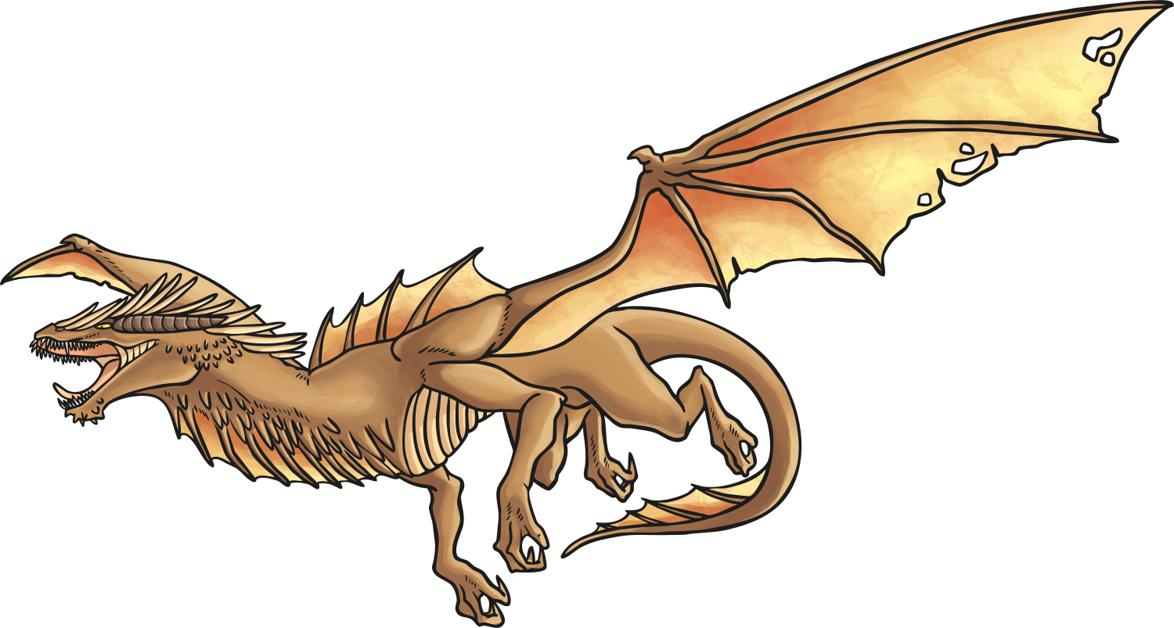

Quiz Time
Read these statements about Anglo Saxon religion. Discuss with your partner which you think are true and which you think are false and your reasons for believing so.
Be ready to feed your ideas back to the rest of the class.
The Anglo Saxons were Pagan when they first came to Britain.
The Anglo Saxons believed in many gods.
The Anglo Saxons believed that magic spells and lucky charms would protect them.
The Anglo Saxons thought that burning down crops would keep ghosts away.
The Anglo Saxons believed in dragons and elves.

Slide 3

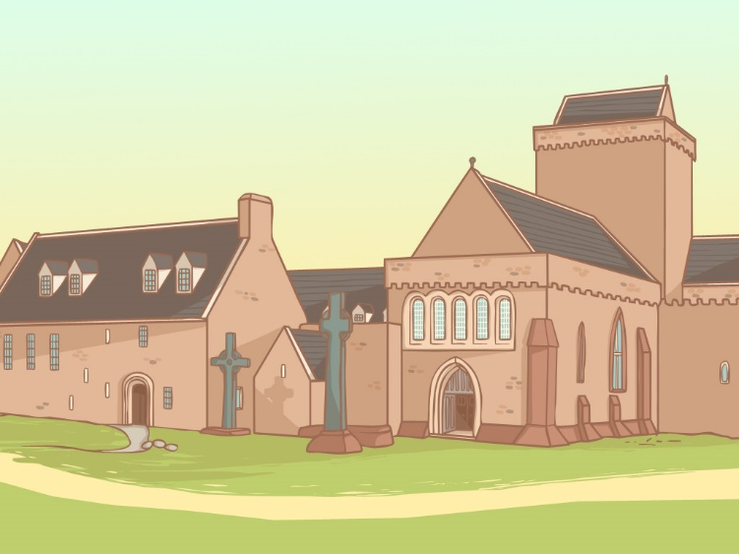
Anglo-Saxon Religion
The early Anglo-Saxons were Pagans but over the course of approximately one hundred years, they were converted to Christianity.
With your partner discuss the following questions:
What do you know about these two religions?
What are the similarities and differences?
Be ready to feedback your ideas to the rest of the class.

Slide 4
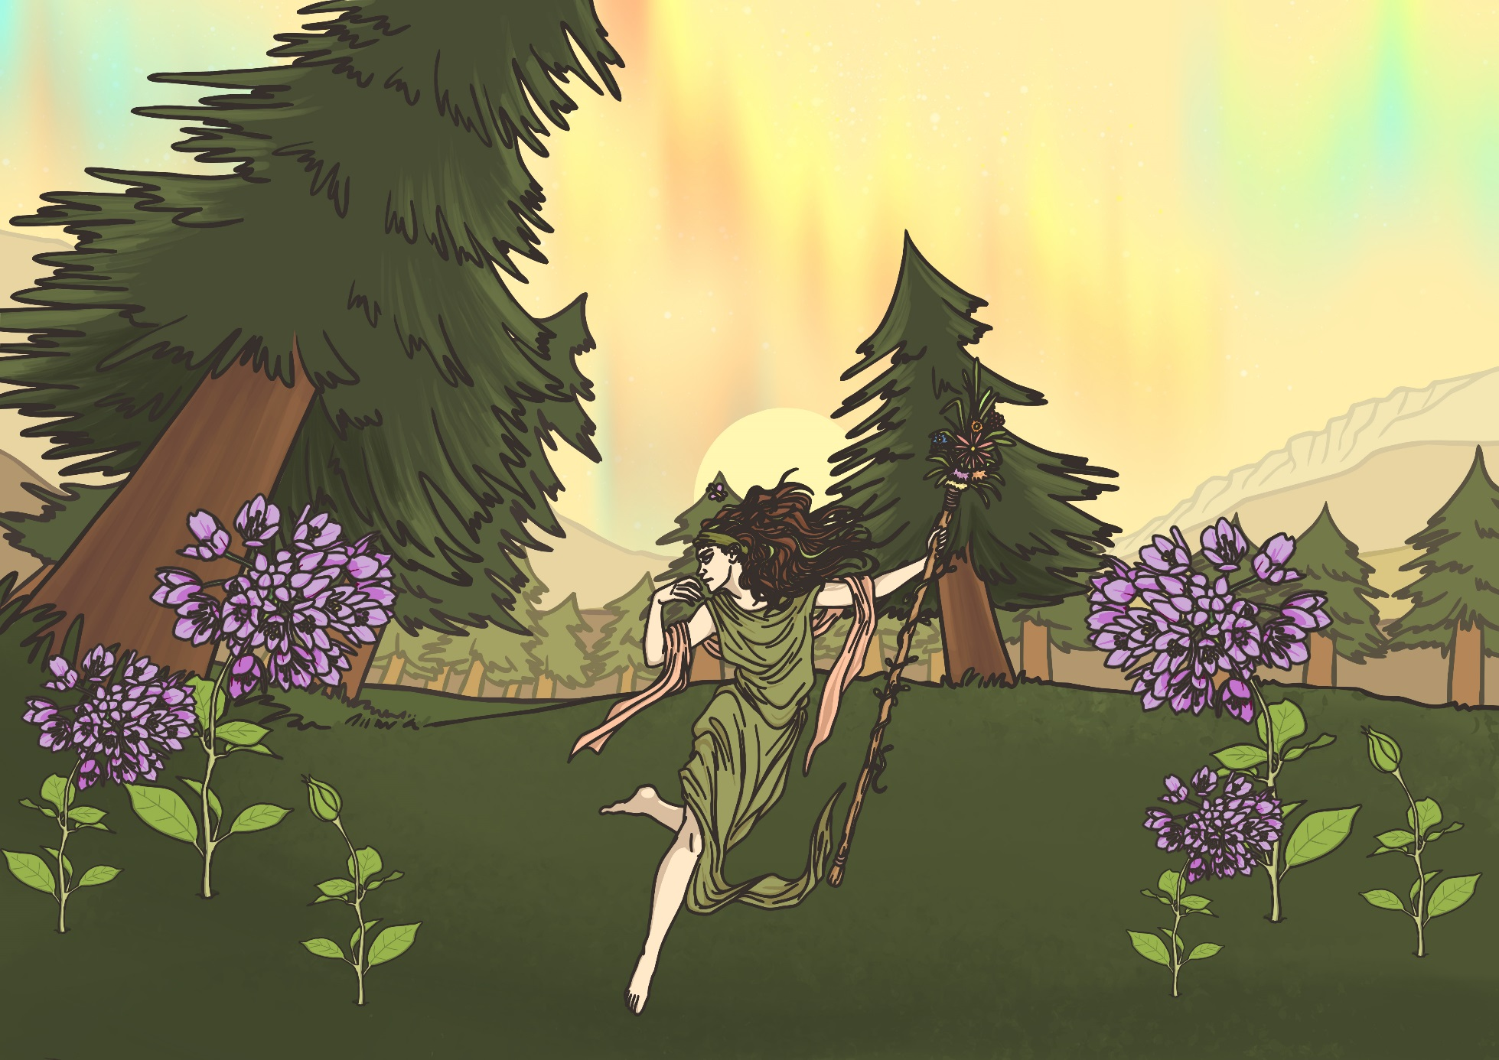
Changing Religions
When the Romans were in Britain many people had become Christians, but when the Anglo-Saxons invaded and settled, Christians only carried on in places where the Anglo-Saxons did not live.
The Anglo-Saxons brought their pagan religion with them to Britain and Christianity ceased to be the main religion.

Slide 5
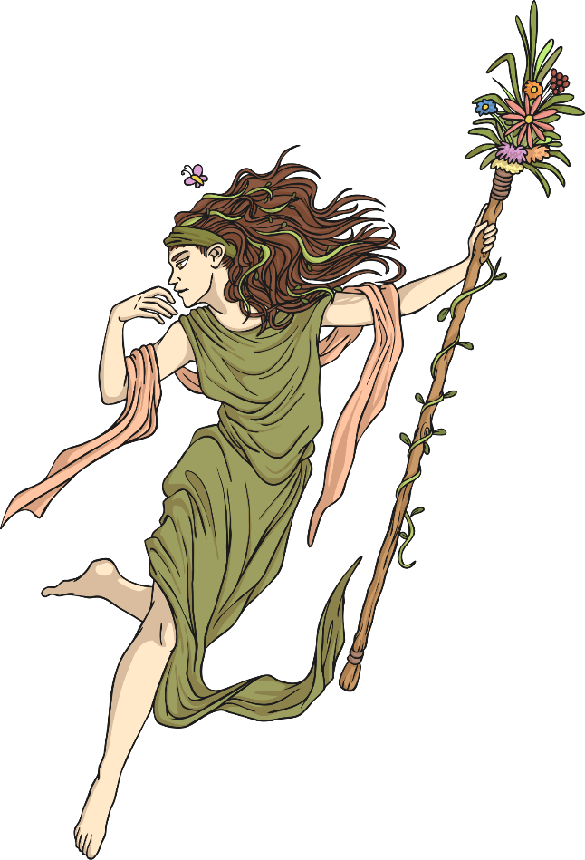
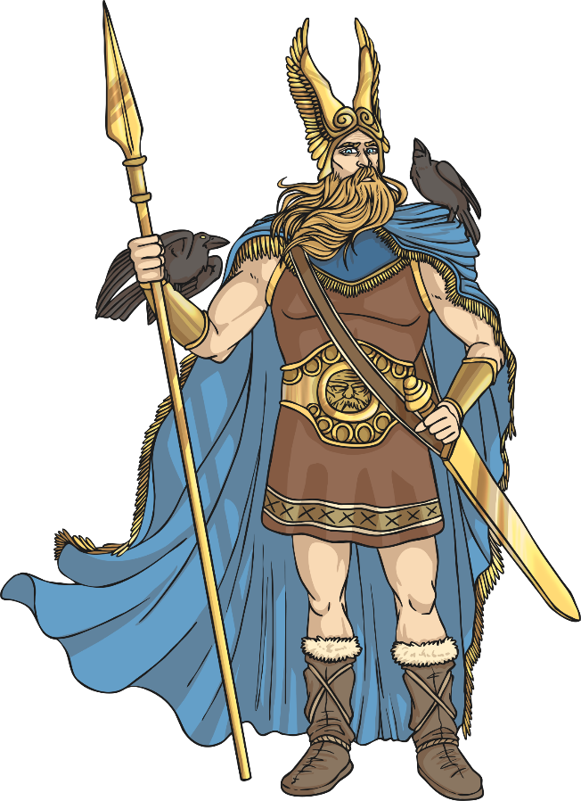
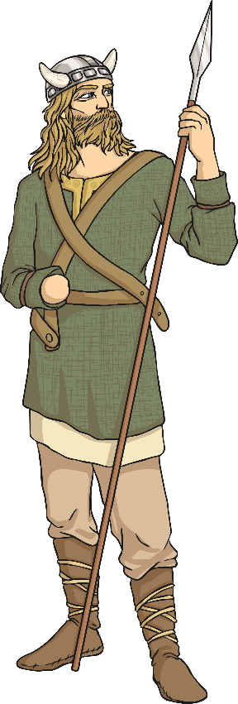
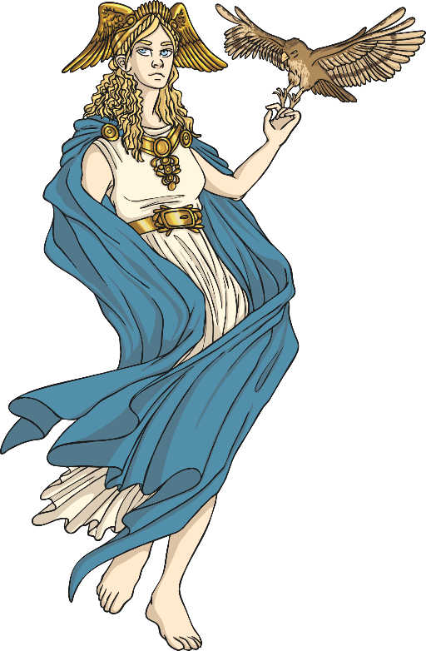
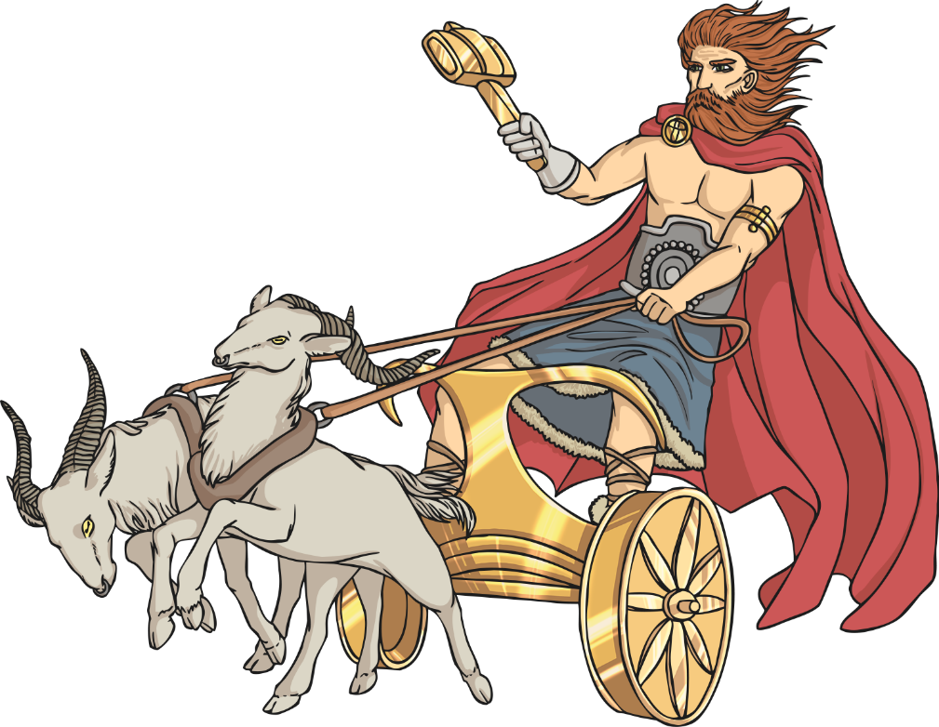
Paganism
The religion of the early Anglo Saxon people was Paganism. Paganism is a polytheistic religion, which means many gods are worshipped.

Slide 6
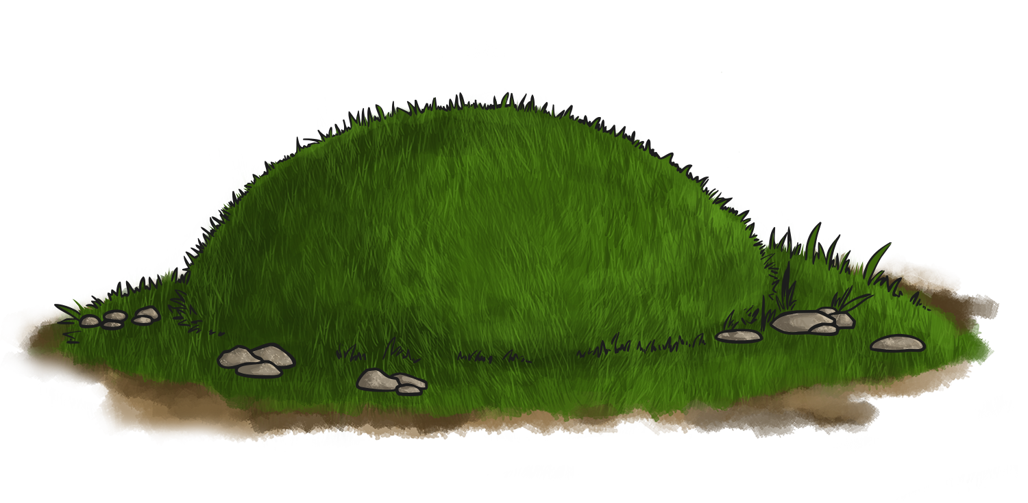
Magic and Spells
The Anglo Saxon people were very superstitious.
They believed in good and bad omens, lucky charms, spells and magic as they thought that these things could influence what happened in different aspects of their lives.
The Anglo Saxons performed many rituals that they believed would protect them in this life and the next. This was especially true about the way they dealt with the dead. It was common to bury a person with their belongings as the Anglo Saxons believed the dead person would need these in the afterlife. Some people were even buried with a slave or pet!

Slide 7

Festivals
There were many Anglo Saxon festivals throughout the year. During the festivals different gods were worshipped.
The people would pray to the gods and make sacrifices of objects and animals. It is believed that bonfires were common during the festivals and that people would dance around or over them and throw herbs and other offerings into the flames.
Why do you think the Anglo Saxon people made sacrifices to the gods?

Slide 8
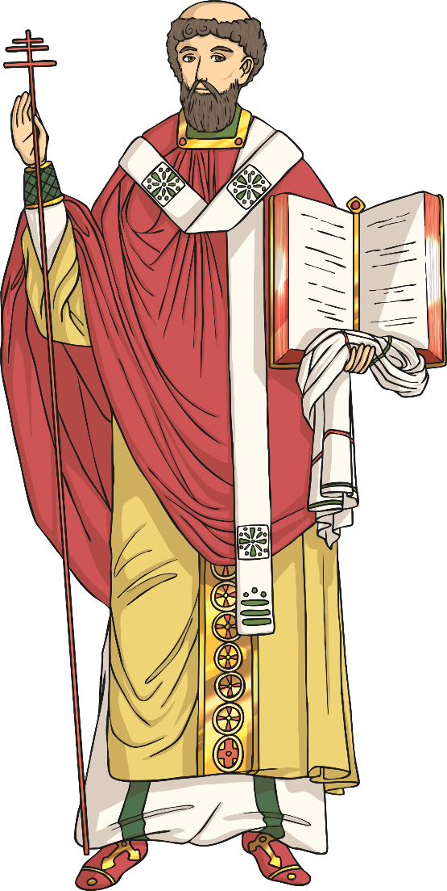
De Temporum Ratione
Most of what we know about the Anglo Saxon festivals comes from a book called De Temporum Ratione (which mean The Reckoning of Time). It was written by a Christian monk called Bede in 725AD.
In the book the Venerable Bede describes the Anglo Saxon calendar and details of the different festivals that were held in the months throughout the year.
What festivals do you celebrate each year?

Slide 9
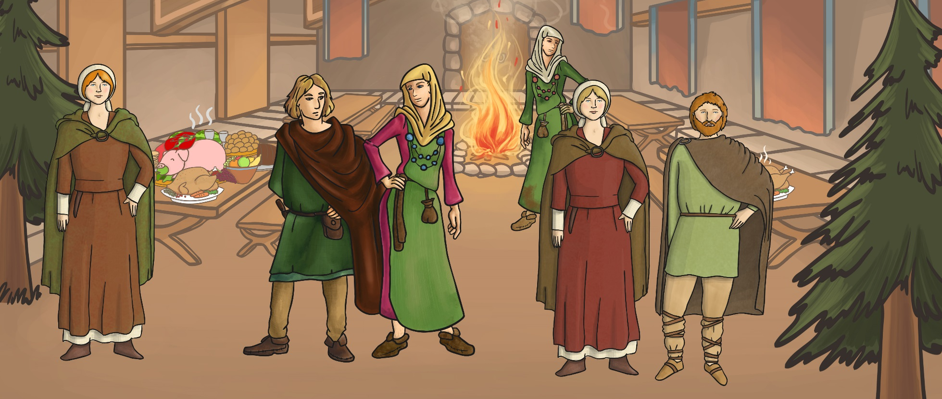
Modraniht (Mother Night)
Bede said that this was the main Pagan festival which was celebrated on the winter solstice (around the 25th December) each year. It marked the start of the Anglo Saxon year.
During the festival Bede reports that the Anglo Saxons would have a big feast, decorate their villages and houses with evergreen branches and burn a yule log.
What Christian festival does this remind you of?

Slide 10
Eostremonath
The most important spring festival was held during Eostremonath (April).
During this festival the goddess Eostre was worshipped and people gave eggs as gifts. The festival celebrates rebirth and marks out the start of the warmer months.
What Christian festival does this remind you of?

Slide 11
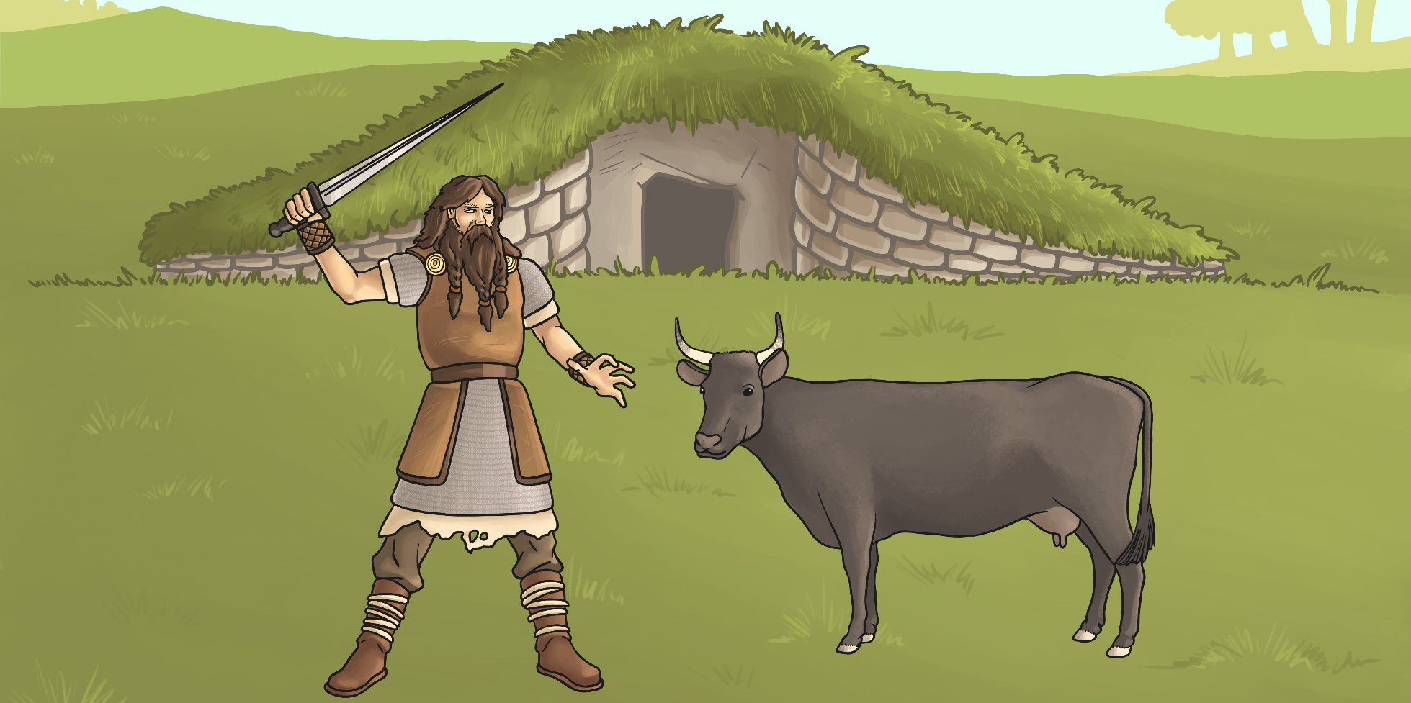
Blodmonath
Blodmonath was the Anglo Saxon month of November. It means ‘blood month’ or ‘month of sacrifice’. During the festival of Blodmonath, people made offerings to the gods by sacrificing their animals.
Why do you think the Anglo Saxons sacrificed their animals during the Blodmonath festival?

Slide 12



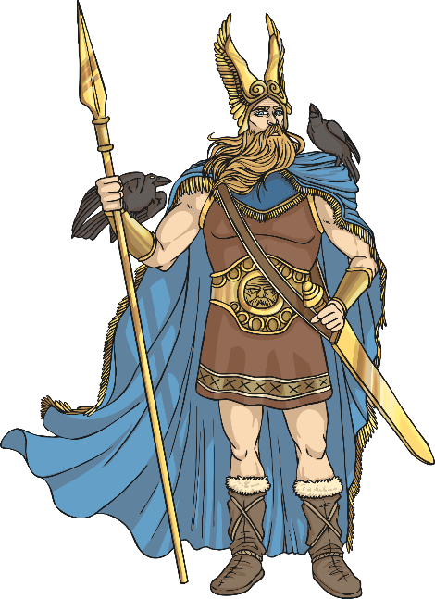
Anglo Saxon Gods
The Anglo Saxons believed in lots of different gods who they believed represented and were responsible for different things.
The people prayed to the gods in hope that they would offer protection or provide them with the things they needed.
Today we are going to learn about some of the main Anglo Saxon gods.
https://www.youtube.com/watch?v=IO4V1a-XrYA

Slide 13

Woden
Woden was the chief of the Anglo Saxon gods.
He was the god of battle and war.
Woden was also believed to be the observer of humans and the Anglo Saxons thought he may visit them in disguise.
His special animal was the wolf and he had two wolves as pets.
His special object was a spear.
The day of the week Wednesday was named after him.

Slide 14

Frige
Frige was the wife of Woden.
She was the goddess of the household and childbirth and people would pray to her to ask for a good birth.
Her name means ‘beloved’.
Her symbols are the stork and the spinning wheel.
The day of the week Friday is named after her.

Slide 15

Thunor
Thunor was the god of thunder. He is also known as Thor.
Thunor was known as the protector of humans against threats.
He has a hammer as his symbol.
Goats are his special animal as they were believed to pull his chariot.
Thunor was the son of Woden and Frigg.
The day of the week Thursday is named after him.

Slide 16

Tiw
Tiw is another god of war.
He is associated with being courageous and making sacrifices in battle.
His special animal is the wolf.
He is often shown with only one hand, as legend says a wolf bit off the other one.
The day of the week Tuesday is named after him.

Slide 17

Eostre
Eostre was the goddess who was worshipped during Eostremonath (April).
Eostremonath is associated with rebirth and the giving of eggs.
Her symbol is the hare.
People would pray to Eostre to ask for good fortune in the coming summer months.
It is thought that Pagans offered hot cross buns to Eostre during Eostremonath and the four quarters represented the quarters of the moon.

Slide 18
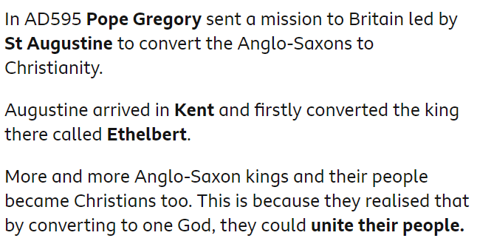
How did the Anglo-Saxons become Christians?
https://www.youtube.com/watch?v=GDsowXJtMW0
https://www.bbc.co.uk/bitesize/topics/zxsbcdm/articles/zs3gcdm#zd63bqt

Slide 19
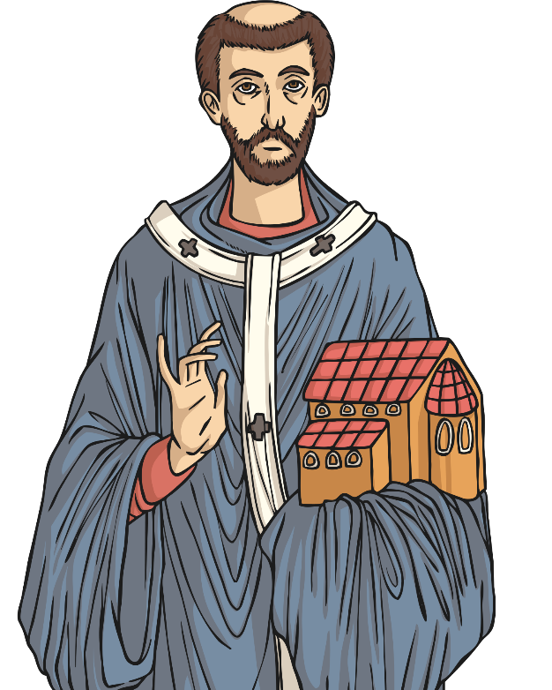
Christian Mission
In 597AD, Pope Gregory the Great from Rome sent a Roman monk called Augustine (early 6th century – 604AD) to Britain to tell the Anglo-Saxons all about Christianity, and persuade them to become Christians.
Augustine arrived in Kent and set about his work. King Ethelbert, who was the king of Kent at the time, allowed him to preach to the people to teach them all about Christianity.
Augustine converted King Ethelbert of Kent to Christianity soon after his arrival. Ethelbert was baptised and became the first Anglo-Saxon Christian king.
On Christmas day 597AD, Augustine baptised 10,000 of the kings’ subjects. The mission was proving to be a great success!
Augustine was made a saint after his death in recognition of his work.

Slide 20
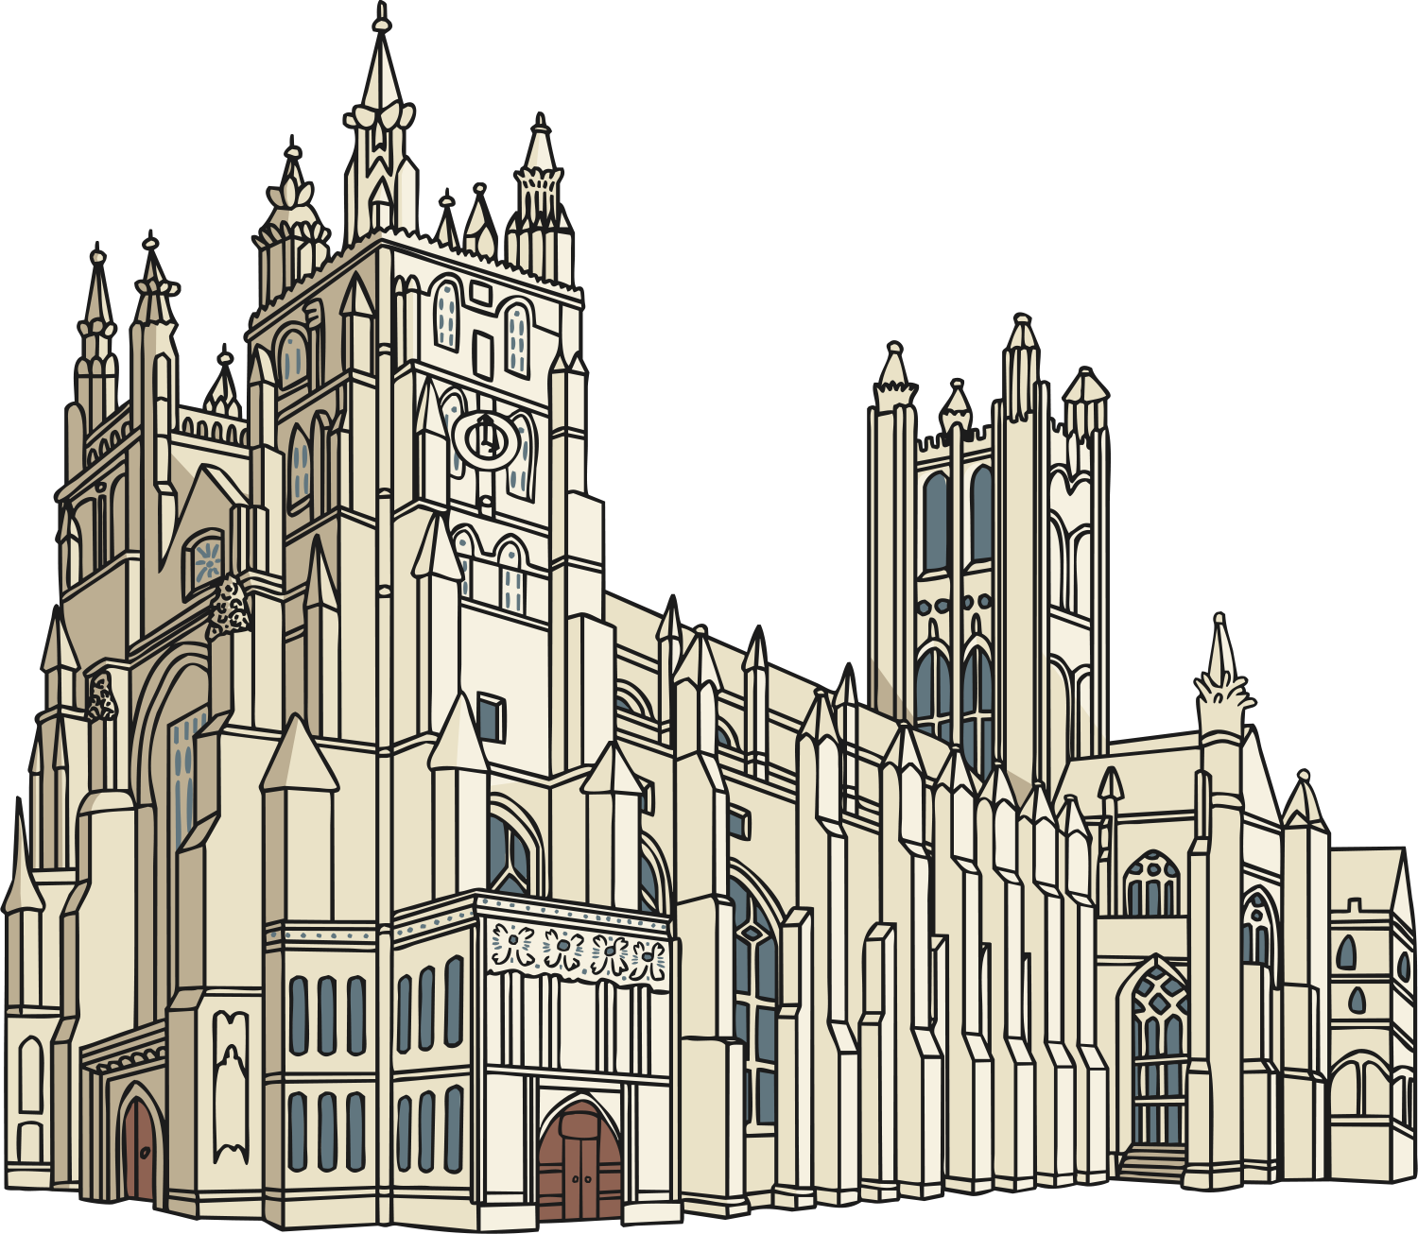
Canterbury Cathedral
Augustine founded Canterbury Cathedral and became the first Archbishop of Canterbury. The cathedral had to be rebuilt in 1070AD following a major fire. It is thought that Augustine’s original building is located under the nave of the cathedral.
Today the Archbishop of Canterbury is also the head of the Church of England and Canterbury Cathedral is one of the most important and famous Christian buildings in the world.

Slide 21
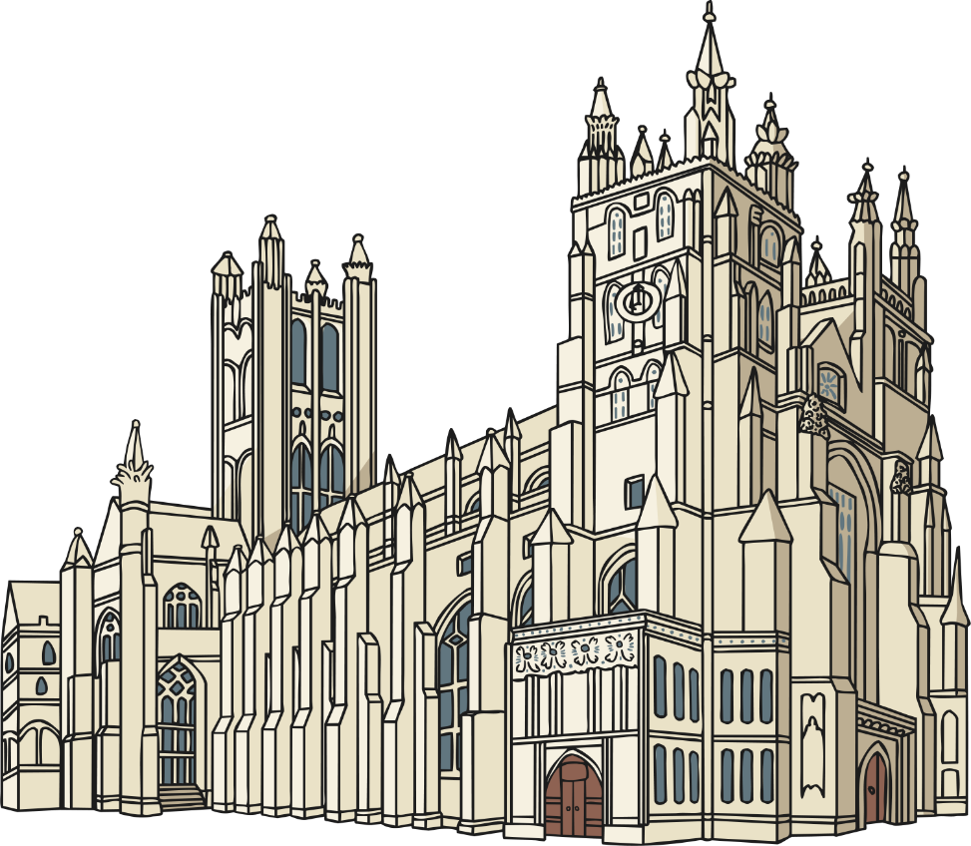
Spreading the Word
The kingdom of Kent was the first Anglo-Saxon kingdom to convert to Christianity, but over the next hundred years the rest of Britain gradually converted to Christianity too. Other missionaries spread the word about Christianity around the country and more and more people were converted to the religion.

Slide 22
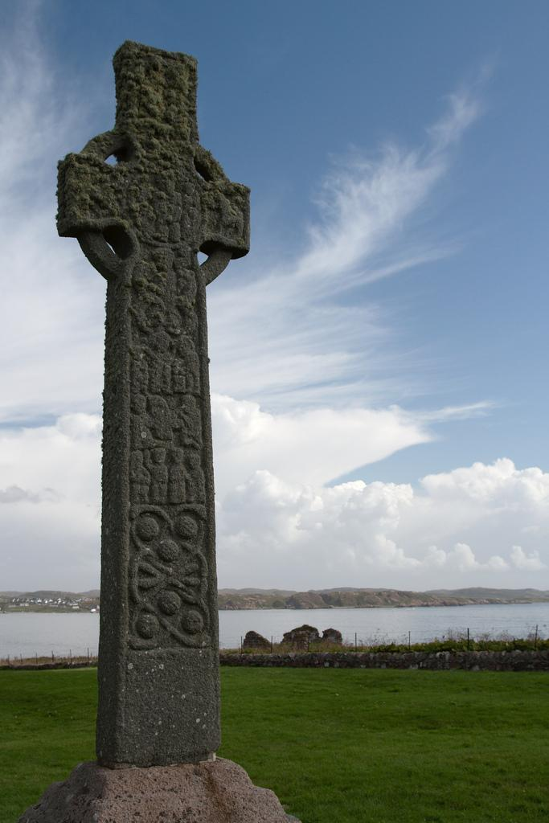
Celtic Christianity
Before St. Augustine even arrived in Britain there were places where Christianity was growing and thriving.
By the early 6th century, many Irish people were already practising the Celtic form of Christianity and there were lots of monasteries in Ireland teaching the religion.
Missionaries from Ireland were sent to Scotland and England to preach Christianity and encourage people to follow the religion.

Slide 23
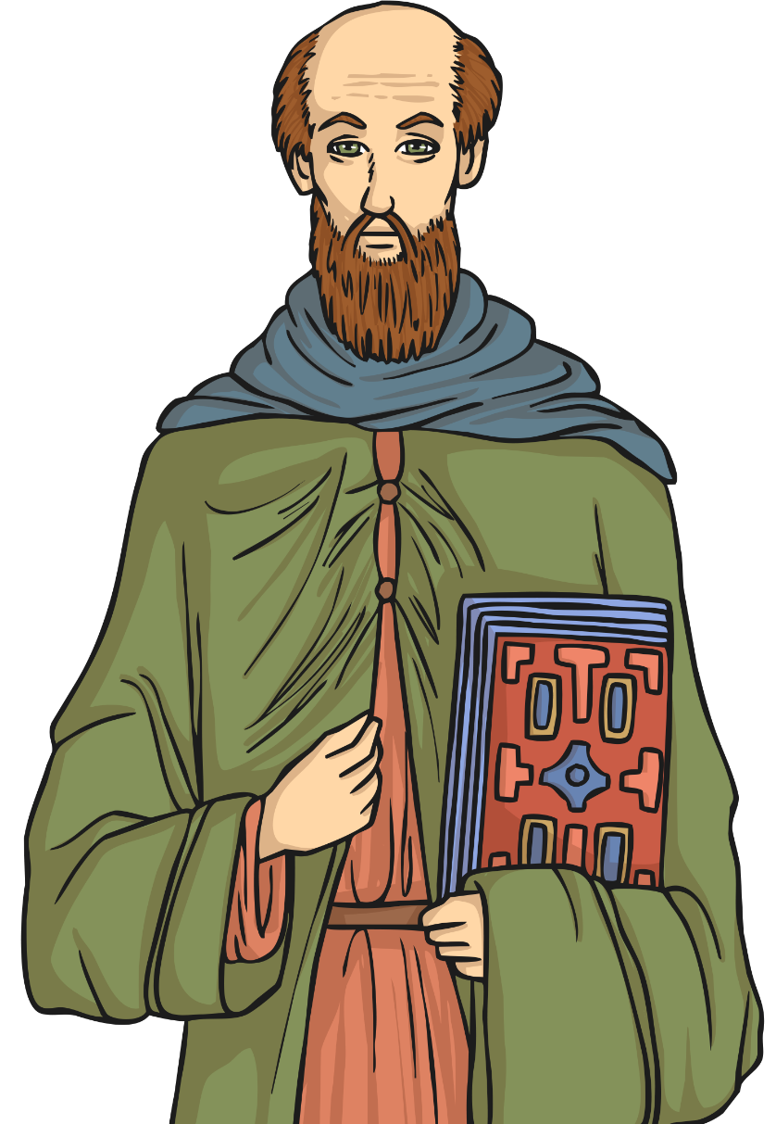
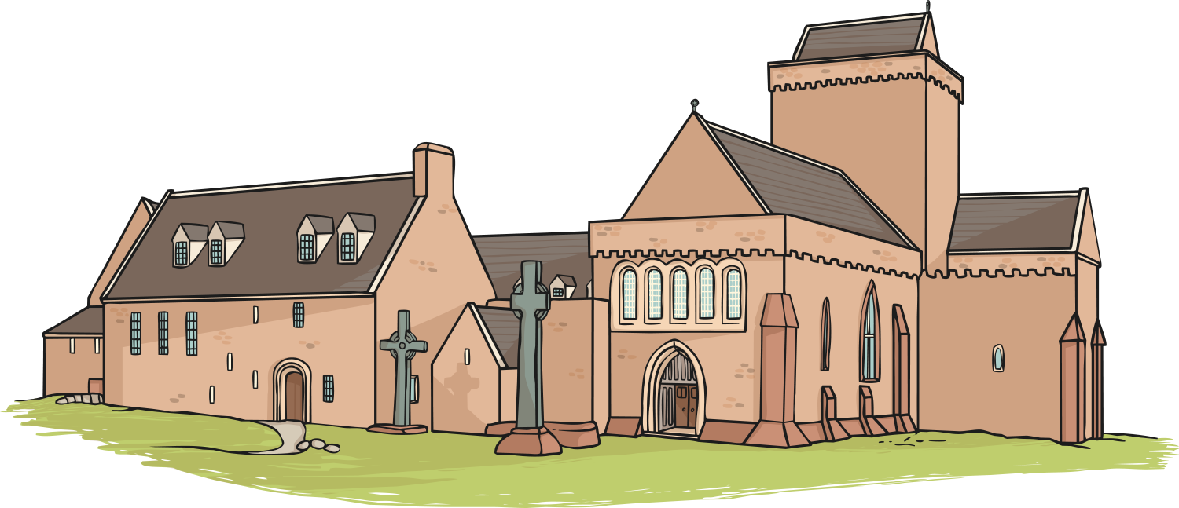
St. Columba and Iona
A famous Irish abbot (head monk from a monastery) called Columba (521AD – 597AD) was particularly successful in introducing Christianity to Scotland.
In 563AD, Columba left Ireland and founded a very important and influential abbey on the Island of Iona, just off the west coast of Scotland. Then, around 565AD, he converted the Northern Pictish King, King Bridei to Christianity.
The remains of Columba’s abbey are still visible on Iona today and Columba’s missionary work earned him the title of saint after his death in 597AD.

Slide 24
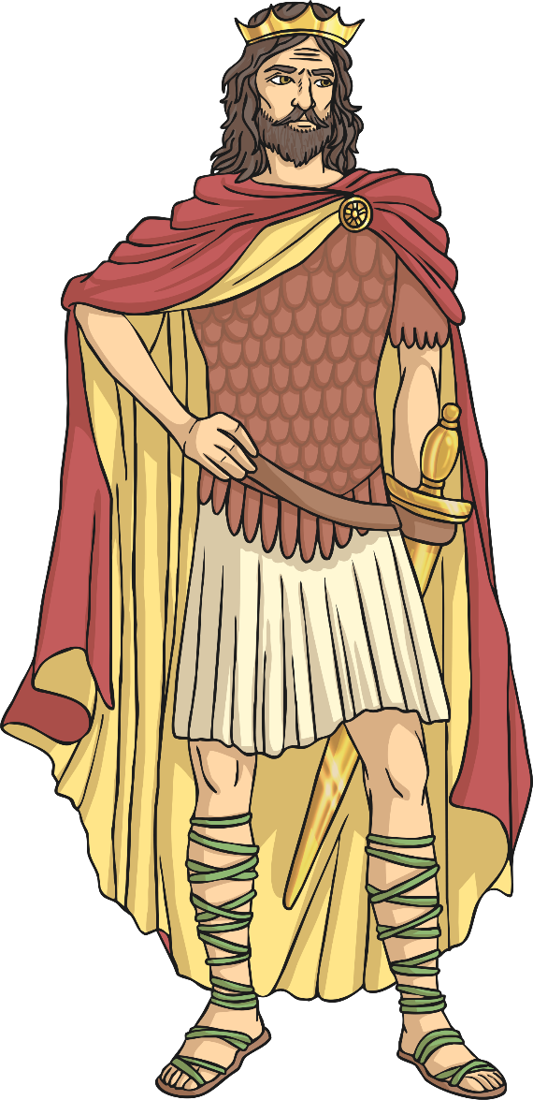
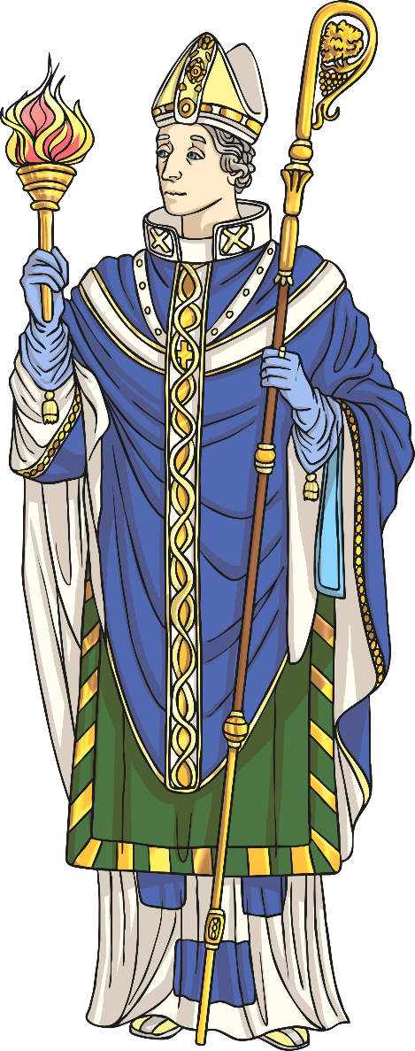
Oswald and Aidan
Oswald (born 604AD) was the King of Northumbria from 634AD until he was killed in battle in 642AD. Oswald did a lot to promote the spread of Christianity and he is regarded as a saintly king in the writings of the historian Bede.
In 635AD Oswald asked the monks at Iona to help him teach the people of Northumbria about Christianity.
A monk called Aidan (590AD – 651AD) was sent from Iona to Northumbria to help with the mission. Oswald made Aidan a bishop and gave him the island of Lindisfarne where he founded a monastery.
Oswald and Aidan are both revered as saints.

Slide 25
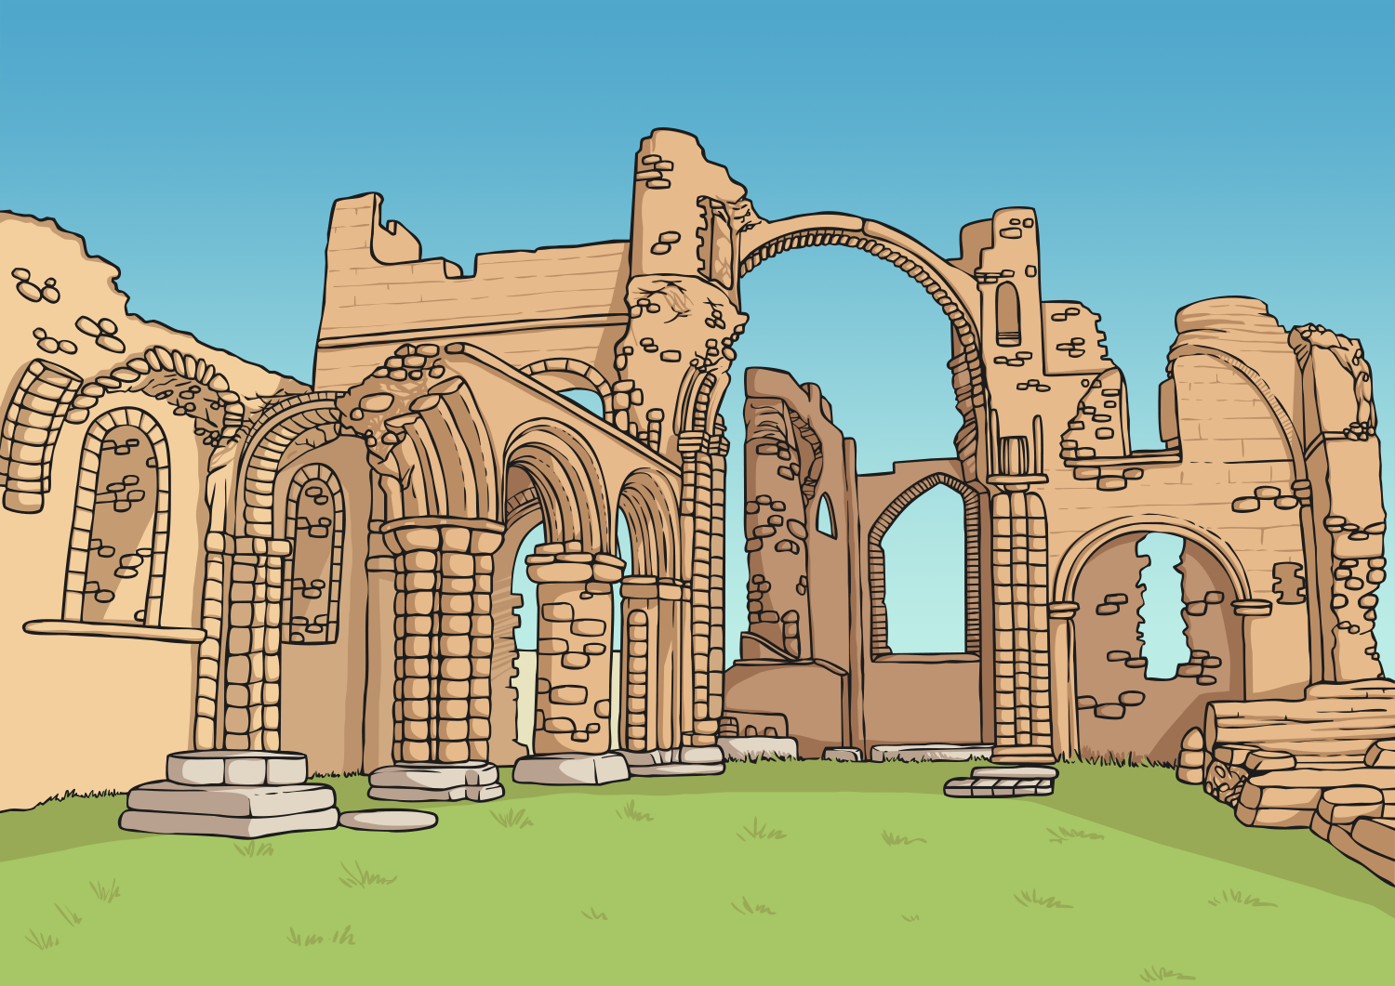
Lindisfarne Priory
Aidan established his priory on the island of Lindisfarne, which is also known as The Holy Island of Lindisfarne or just Holy Island.
Lindisfarne Priory became a very influential place. Using the priory as a base, the monks from Lindisfarne were successfully able to promote the spread of Christianity across the North of England.
Aidan worked hard to teach the people of Northumbria all about Christianity and he was known for his gentle, understanding approach with all the people he talked to.
https://www.bbc.co.uk/bitesize/clips/zjrpr82

Slide 26
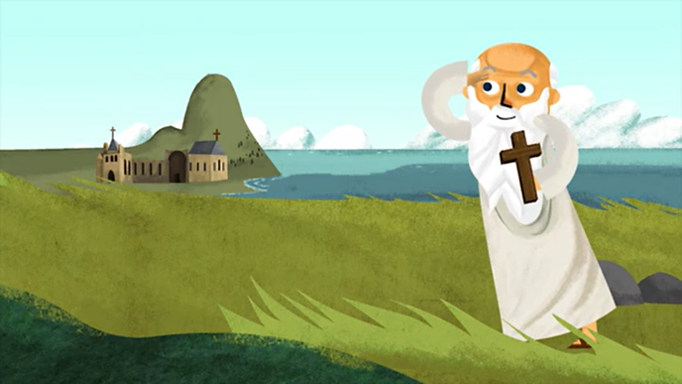
Why were monasteries important?
Monasteries were centres of learning. Monks and nuns spent their time there in prayer and study. They also copied out books by hand and decorated the pages in beautiful colours.
Monasteries were the only schools in Anglo-Saxon England. Boys lived there to train as monks and some girls became nuns.
Roman Christianity was strong in Europe, North Africa and Middle Eastern regions.
St Adrian was a famous abbot (head of a monastery) from North Africa, and was in charge of monasteries in Naples, Italy and the important St Augustine’s, Canterbury.

Slide 27
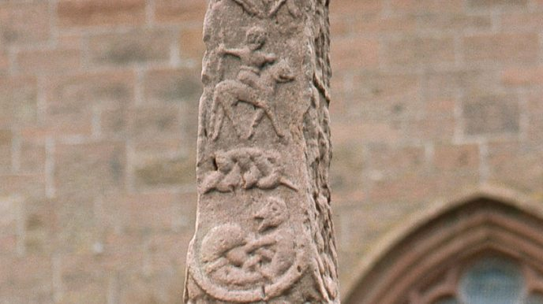
What changed when the Anglo-Saxons converted to Christianity?
Pagan shrines were turned into churches, magic water became holy water, and various pagan gods were gradually turned in Christian saints.
Kings went into battle with priests, their armour and weaponry were carved with texts from the Bible which we know from the Staffordshire Hoard. With God on their side, they could not lose.

