Slide 1
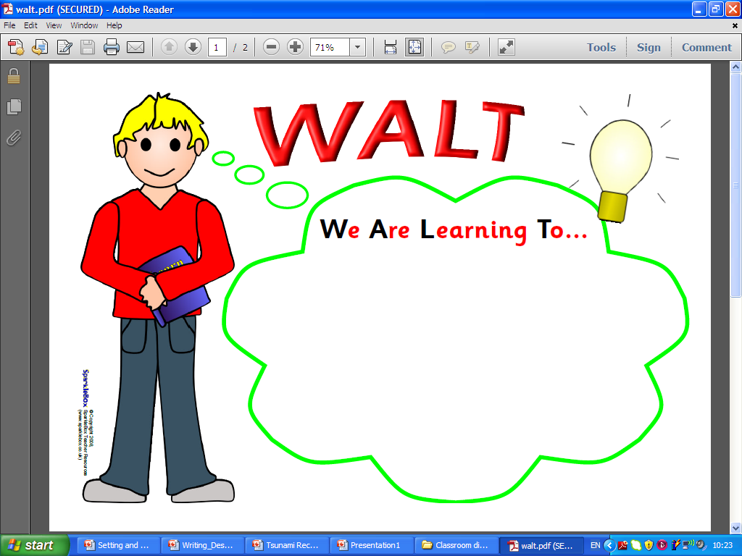
Wednesday 1st May
WALT: Identify features of a newspaper article.

Slide 2
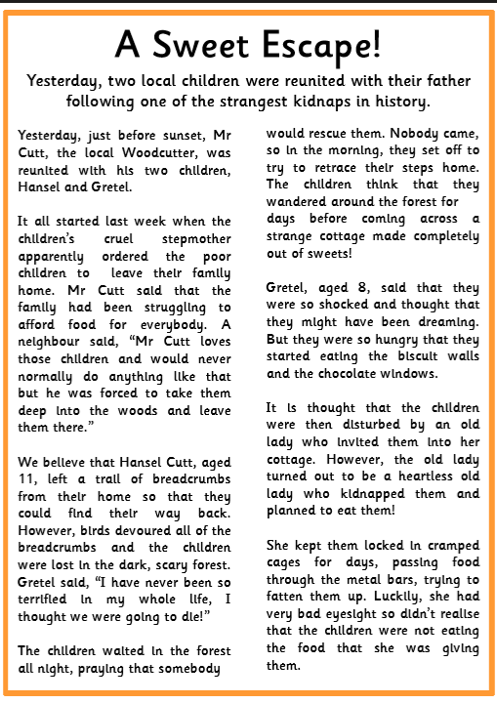
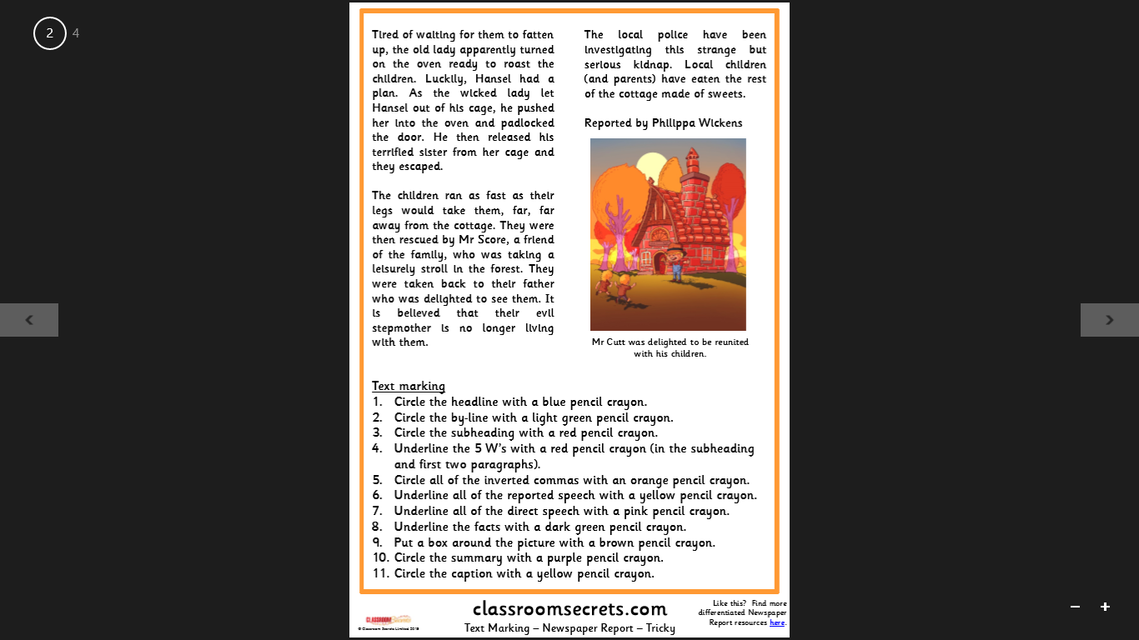
What genre of writing are we focusing on?

Slide 3
Newspaper articles
They inform people about key pieces of news in their local area, country or across the world.
They are a key form of communication.
They report events that have already happened and are of interest to a lot of people.

Slide 4
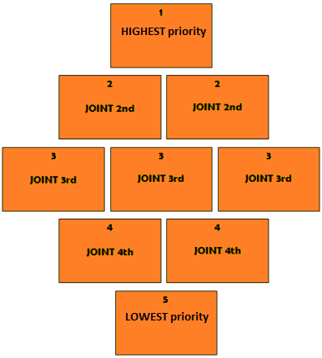
Features of a newspaper article:
Headline
Lead line (subheading)
Introduction
Main body of text
Direct quotes
Conclusion (summary)
Photograph
Caption
By-line
Which features do you think are the most important? Least important?
Create a diamond 9 with the features.

Slide 5
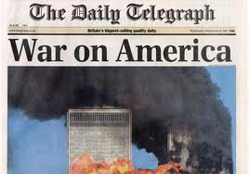





Headline
In bold
Catchy
Alliteration
Rhyme
Interests the reader
Serious or humorous
Only has a few words
Action verbs

Slide 6
Lead line / subheading
This introduces the story and should GRAB our attention further.
It will set the scene and summarise the main points of the article.
It is often only one sentence so you must make it a good one.
Where?
When?
Who?
What?

Slide 7


Introduction
This gives all of the main facts/points about the event.
Don’t repeat too much from the lead line.
Leave the more detailed information for the main body.
the past tense
clear sentences
It answers the questions:
Where?
When?
What?
Who?

Slide 8
Main body of text
This is made up of 2/3/4 paragraphs and includes more detail about the event.
It may discuss the build-up to the event, during the event and immediately after the event.
This is written in:
paragraphs
the past tense
It answers the questions:
detailed sentences
Why?
How?
direct quotes

Slide 9
Direct quote
This is placed within the main body of the article.
There are normally 1 or 2 quotes from differing opinions/viewpoints.
A quote shares a first-hand experience from someone who was there or gives someone’s honest opinion about the event.
You need to consider whether a quote should be formal or informal.
They must be correctly punctuated!

Slide 10
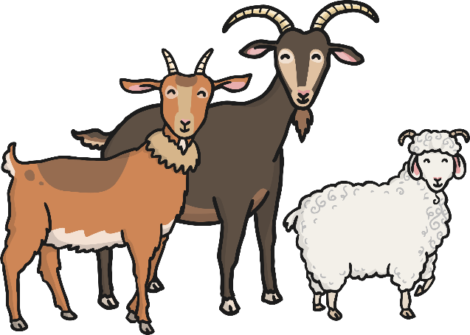
Direct Speech
D
Direct speech uses all of the speech punctuation and rules that we have talked about. It is exactly what is being said by each person.
For example:
‘We can’t let him win! He’s just a grumpy troll!’ said the smallest Billy Goat Gruff.
‘You’re right,’ agreed the biggest Billy Goat Gruff.
The medium-sized Billy Goat Gruff said, ‘So what shall we do?’

Slide 11
Reported Speech
Showing Possession
Reported speech summarises what has been said. It does not usually directly quote the words spoken, so does not need any special punctuation.
For example:
The goats said that they wanted to eat the green grass on the other side of the bridge.
The troll shouted to the goats to stay on their own side of the stream.

Slide 12
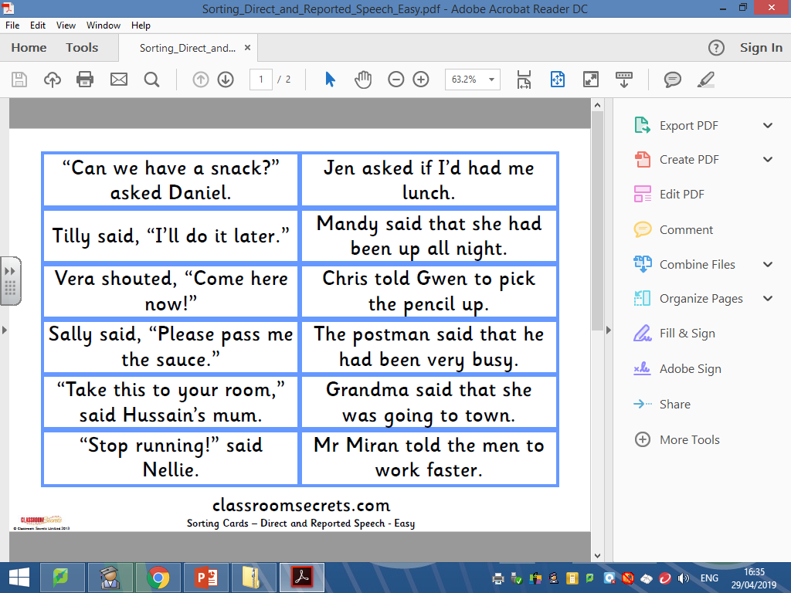
Direct vs Reported Speech
1.)
2.)
3.)
4.)
5.)
6.)
D
7.)
8.)
9.)
10.)
11.)
12.)
In
D
D
In
In
D
In
In
D
In
D

Slide 13
Conclusion / summary
This ends the retelling of events.
It brings us up to date with the current situation.
Because it is telling us what is happening NOW, it will move from the
It might mention what people hope is going to happen next
past tense
present tense

Slide 14


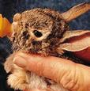
Photo & Caption
The photo shows us a snapshot of what happened, where it happened or who it happened to.
It should make the reader “feel something” so that they want to read the article.
If possible, it should show action.

Slide 15
Also annotate:
What tense is it written in?
What is the lead line?
Where is the introduction?
Where is the conclusion?
How is the writing laid out?

Slide 16
What phrases can you spot that are in a reporting style and could be used in other newspaper reports?

Slide 17
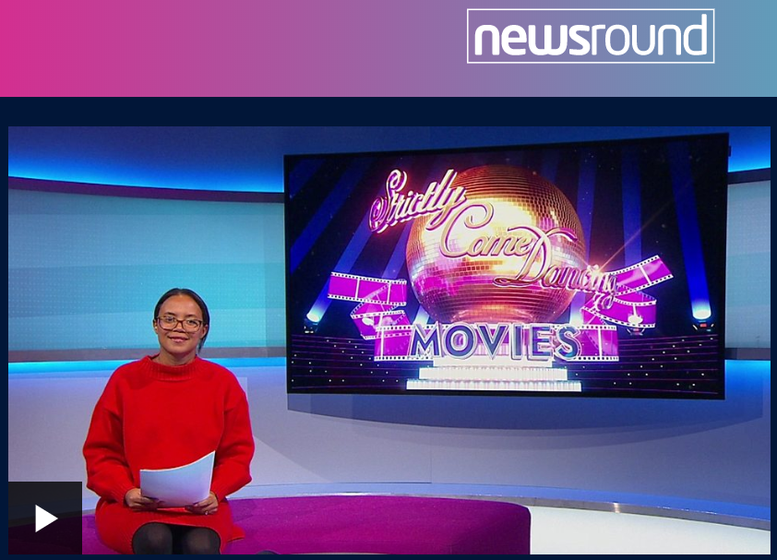
Listen out for any phrases in a reporting style that we could steal for our newspaper reports!
https://www.bbc.co.uk/newsround/news/watch_newsround

