Slide 1
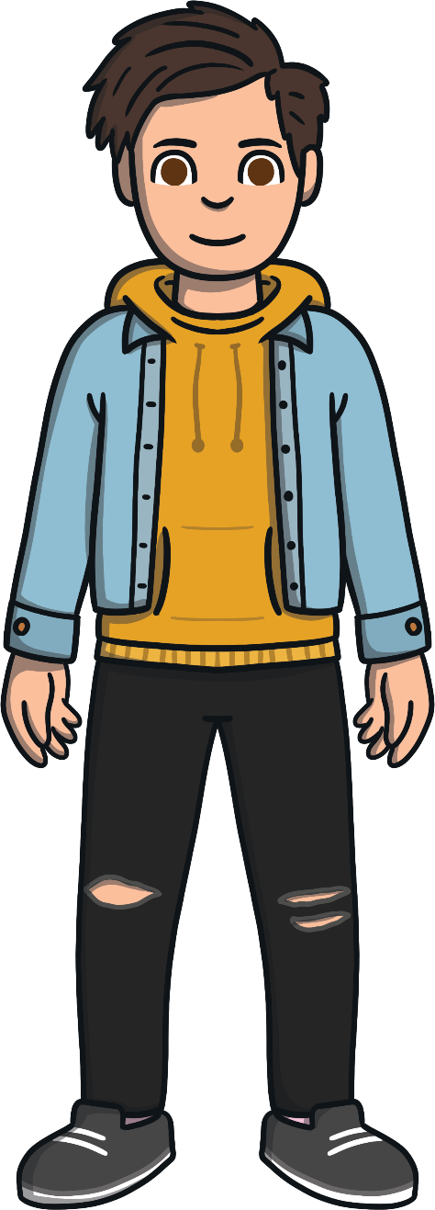
WALT: Identify and use adverbs of manner.
Yesterday, we started exploring adverbs of manner.
Today we are going to continue exploring this as part of our home learning.

Slide 2
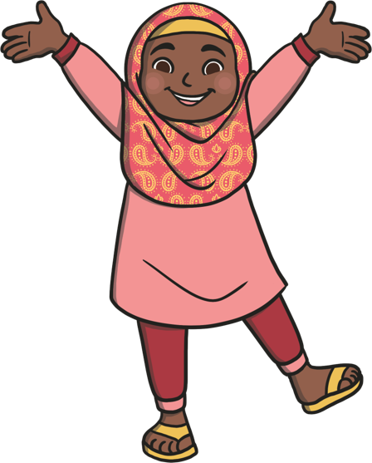
My name is Aiden Adverb. You’ll often find me close to Vafia Verb.
I love to describe her actions.
For example:
Vafia Verb always laughs loudly and she runs quickly.
That’s my job - to tell
you more about a verb.

Slide 3
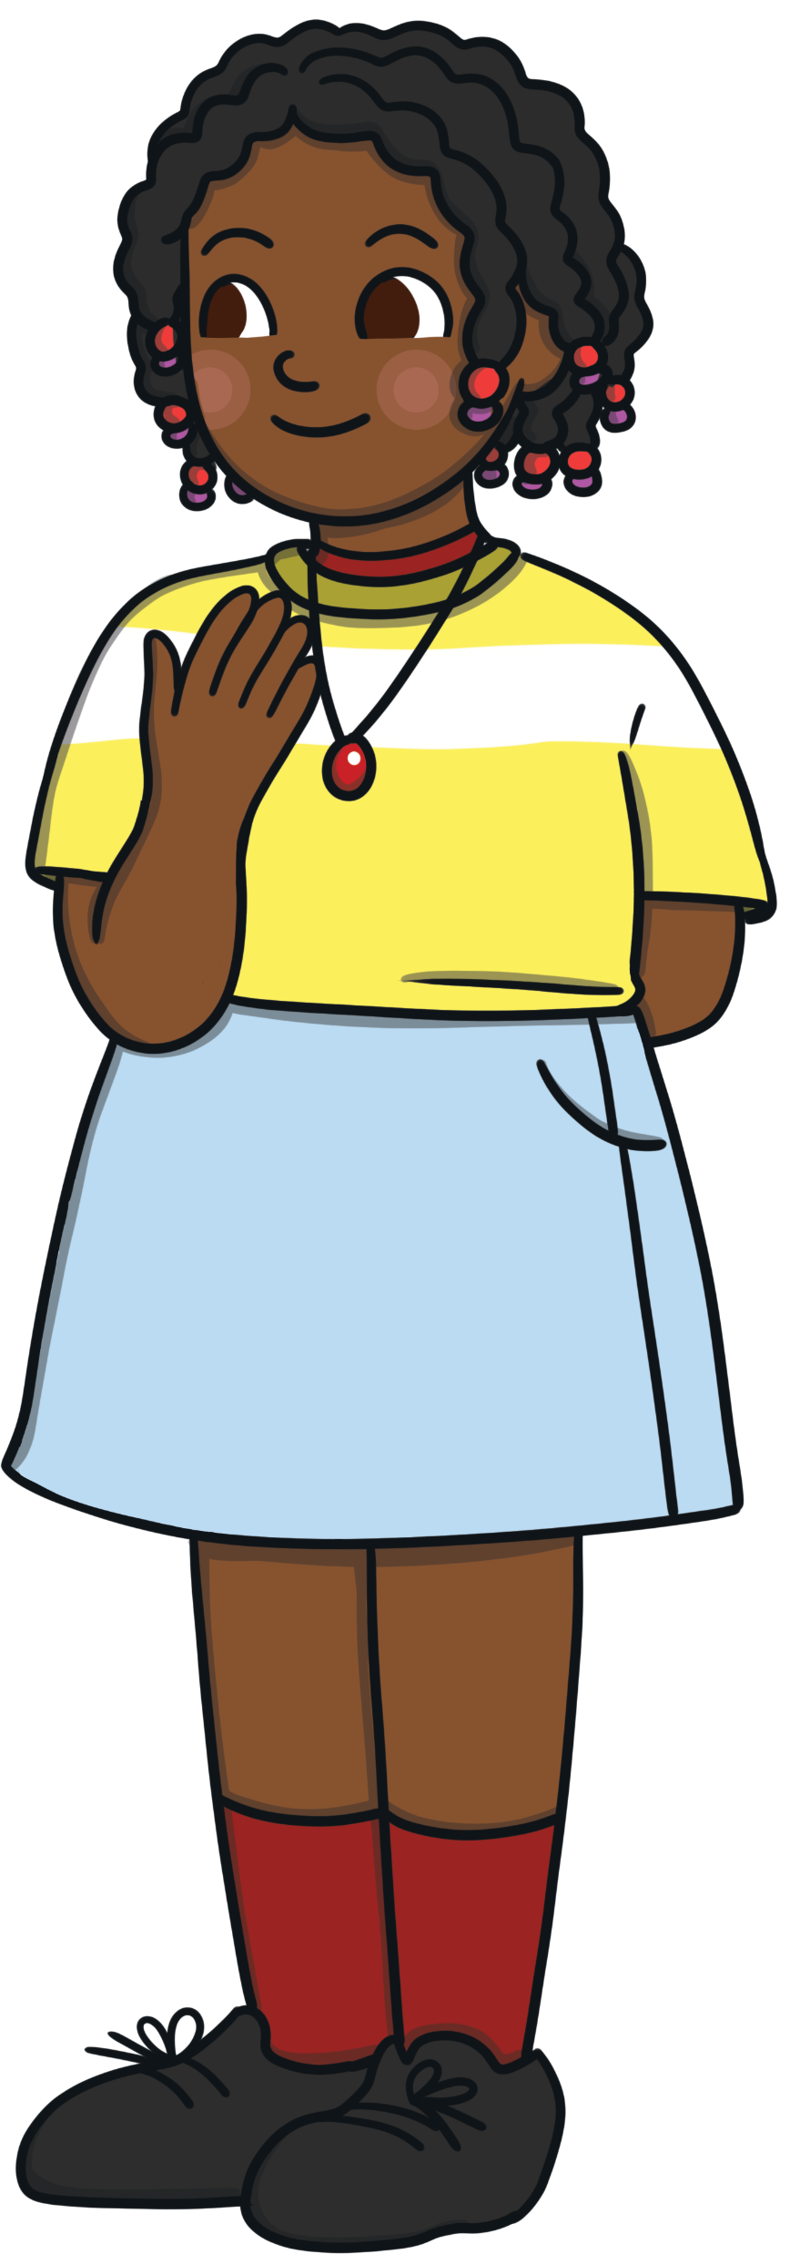
Some adverbs describe how
an action is happening. These are called adverbs of manner.
Helen laughed nervously.
Can you choose one of these adverbs and use it in a sentence?
quickly
Here, ‘nervously’ is describing how Helen laughed, which makes it an adverb.
loudly
sadly

Slide 4
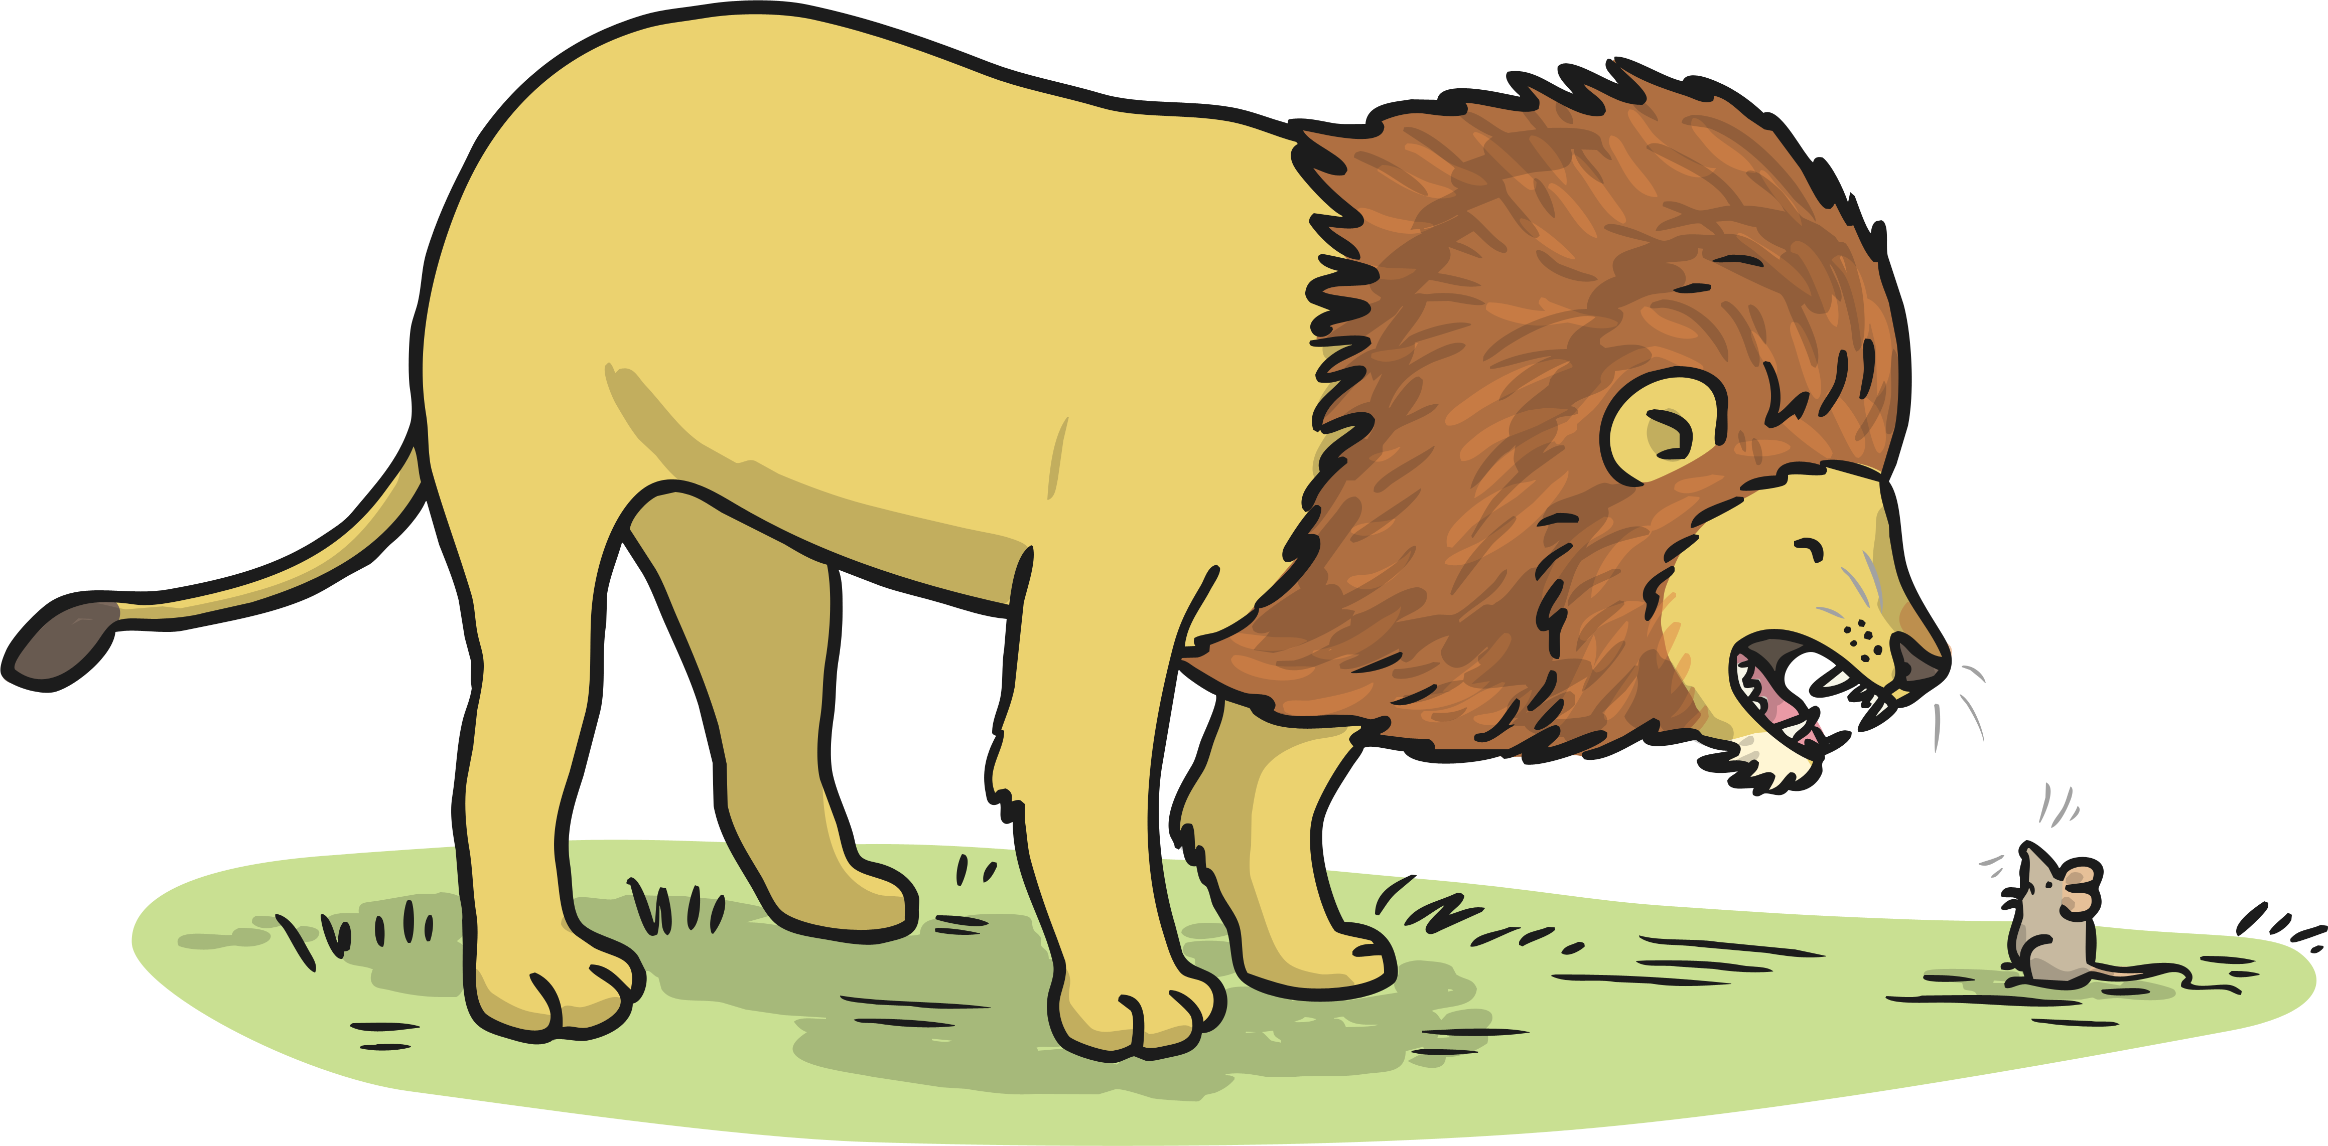
Some adverbs describe how
an action is happening. These are called adverbs of manner.
The lion roared loudly.
Can you choose one of these adverbs and use it in a sentence?
silently
Here, ‘loudly’ is describing how the lion roars, which makes it an adverb.
sneakily
noisily

Slide 5
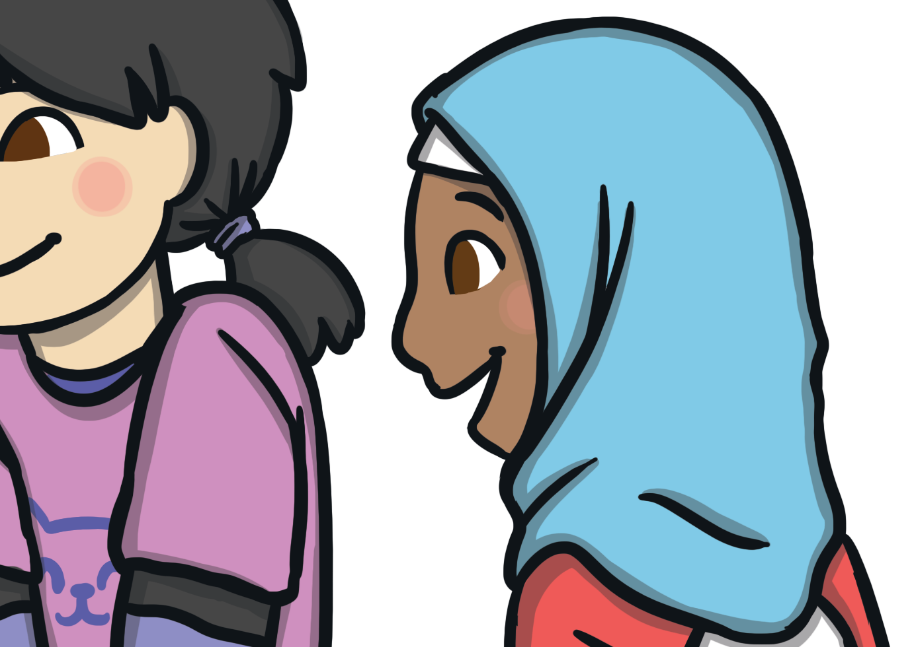
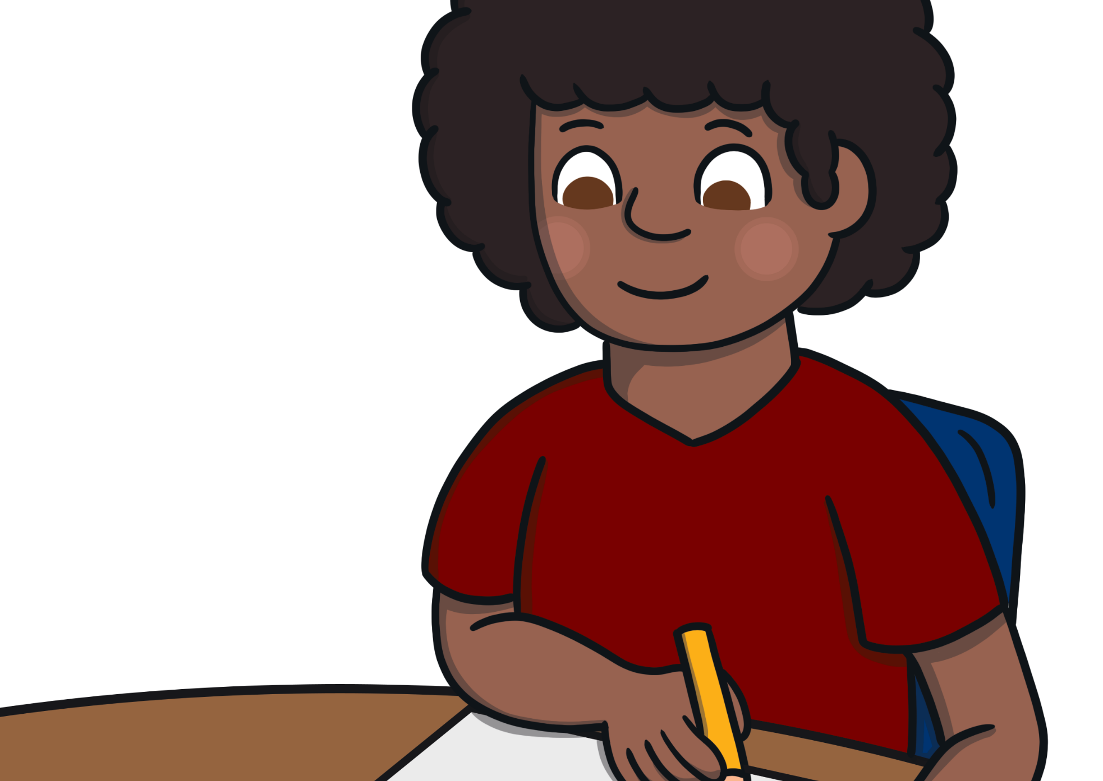
Many adverbs of manner are made by adding ‘ly’ onto the end of the word.
kind + ly = kindly
careful + ly = carefully
Daren coloured his
picture carefully.
Leila smiled kindly.

Slide 6


Can you spot the adverb of manner in this sentence?
Jaamil shouted loudly.
The adverb in blue tells us how Jaamil shouted: he
shouted loudly.
The verb (the
action) is in purple.

Slide 7
Find the adverbs
Eve painted his picture beautifully.
Sarah quickly brushed her hair.
Adam read his books quietly in the library.
Marie swam swiftly without arm bands.
Ted always rides his bike carefully to school.

Slide 8
Can you think of adverbs of manner to complete the following sentences?
It was raining so I ____________ put on my coat.
I made sure that I wrote the letter ____________.
The diver had to travel ___________ to the bottom of the ocean.
I danced ____________ to the music.
I ____________ fell over my bag which was on the floor.
Using adverbs of manner in sentences.

Slide 9
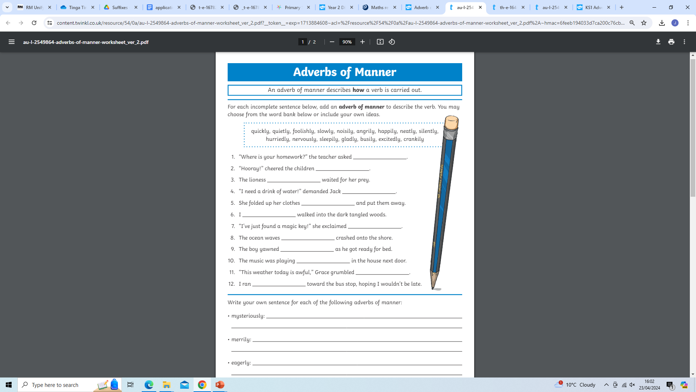
Now complete the activity sheet selecting adverbs of manner to complete the sentences .

