Slide 1
WALT: Revisit the 2 times table.

Slide 2







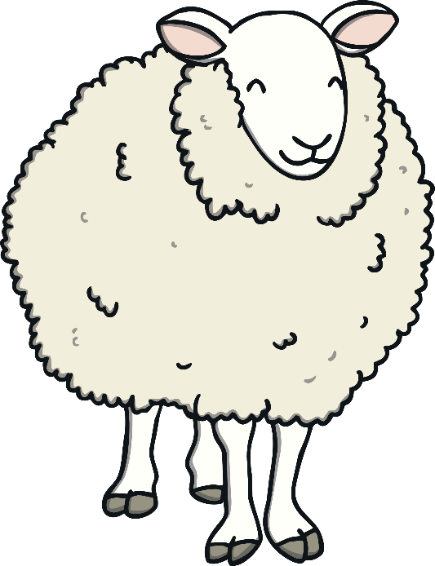

Remember It
Count the objects in 2s as they appear on the slide.

Slide 3


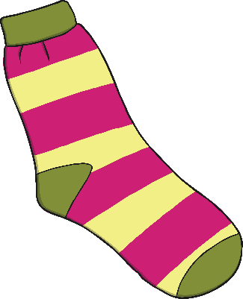
Remember It
How many socks?
There are 6 socks.

Slide 4




Remember It
How many eyes?
There are 12 eyes.

Slide 5









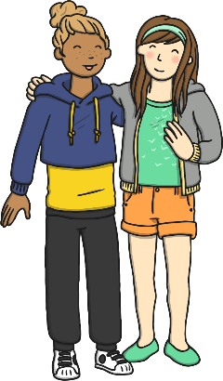

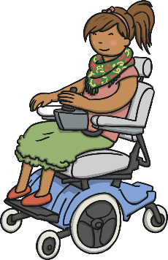



Remember It
How many children?
There are 16 children.

Slide 6

Remember It
How many flowers?
There are 24 flowers.

Slide 7


Remember It
How many fish?
There are 2 fish.

Slide 8
Remember It
How many hands?
There are 0 hands.

Slide 9



Remember It
How many sweets?
There are 14 sweets.

Slide 10
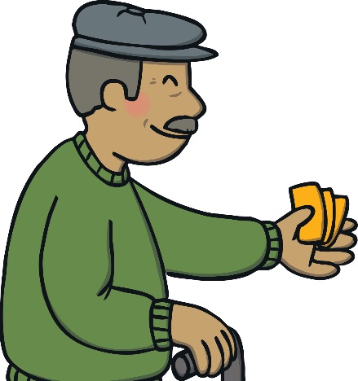

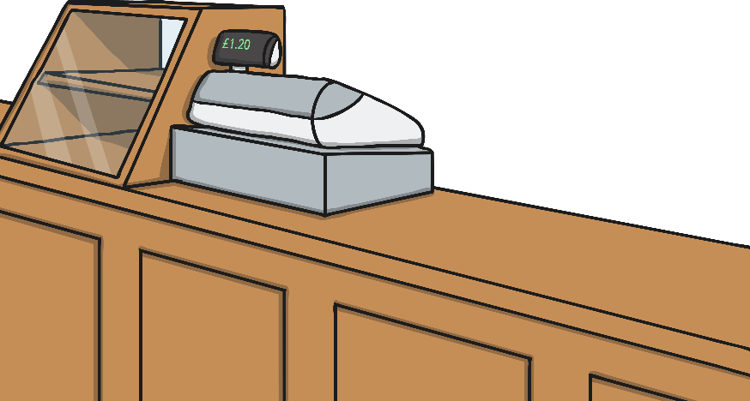

Shelby’s Shoes
?
?
This customer has bought 1 pair of shoes.
How many shoes has he bought?
?
There is 1 pair of shoes.
There are 2 shoes altogether.
The product of 1 and 2 is 2.
2
0
1
2
3
4
5
6
7
8
9
10

Slide 11


Shelby’s Shoes
?
?
This customer has bought 2 pairs of shoes.
How many shoes has she bought? How do you know?
?
There are 2 pairs of shoes.
There are 4 shoes altogether.
The product of 2 and 2 is 4.
2
2
0
1
2
3
4
5
6
7
8
9
10

Slide 12
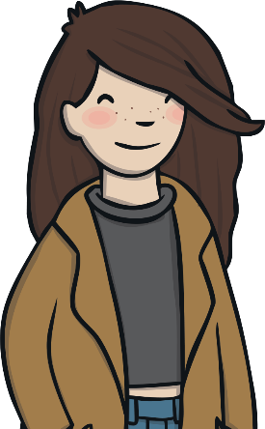

Shelby’s Shoes
?
?
This customer has bought 3 pairs of shoes.
How many shoes has she bought?
?
There are 3 pairs of shoes.
There are 6 shoes altogether.
The product of 3 and 2 is 6.
2
2
2
0
1
2
3
4
5
6
7
8
9
10

Slide 13
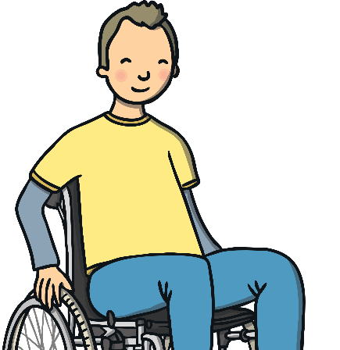

Shelby’s Shoes
?
?
This customer has bought 4 pairs of shoes.
?
How many pairs of shoes has he bought?
4
How many shoes are there altogether?
8
2
2
2
2
0
1
2
3
4
5
6
7
8
9
10

Slide 14

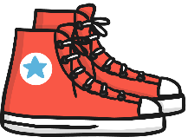
Shelby’s Shoes
?
?
This customer has bought 5 pairs of shoes.
Write a calculation to represent this.
?
5 × 2 = 10
Five groups of two shoes is ten.
or
2 × 5 = 10
Two shoes, five times equals ten.
2
2
2
2
2
0
1
2
3
4
5
6
7
8
9
10

Slide 15

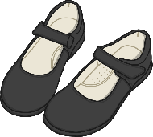
Shelby’s Shoes
?
?
This customer has bought 6 pairs of shoes.
How many shoes has she bought?
?
6 groups of 2 is 12.
2
2
2
2
2
2
0
1
2
3
4
5
6
7
8
9
10
11
12
13
14
15
16

Slide 16
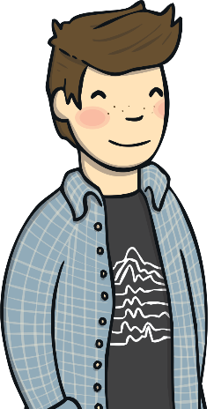
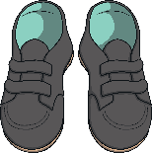
Shelby’s Shoes
?
?
This customer has bought 7 pairs of shoes.
How many shoes has he bought? How do you know?
?
The product of 7 and 2 is 14.
2
2
2
2
2
2
2
0
1
2
3
4
5
6
7
8
9
10
11
12
13
14
15
16

Slide 17



Shelby’s Shoes
?
?
This customer has bought 8 pairs of shoes.
How many shoes has she bought? Write a calculation for this.
?
8 × 2 = 16
2
2
2
2
2
2
2
2
0
1
2
3
4
5
6
7
8
9
10
11
12
13
14
15
16

Slide 18

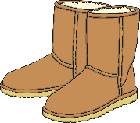
Shelby’s Shoes
?
?
This customer has bought 9 pairs of shoes.
How many shoes has she bought?
?
18
2
2
2
2
2
2
2
2
2
0
1
2
3
4
5
6
7
8
9
10
11
12
13
14
15
16
17
18
19
20
21
22
23
24

Slide 19
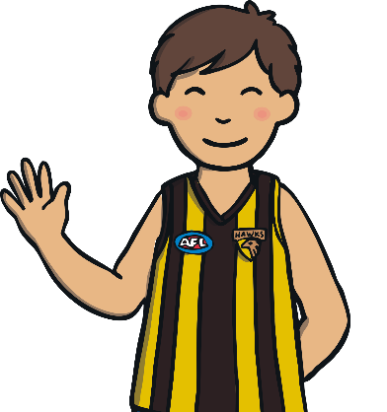
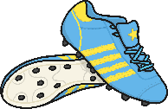
Shelby’s Shoes
?
?
This customer has bought 10 pairs of shoes.
What do you know?
?
There are 10 pairs of shoes.
There are 20 shoes altogether.
The product of 10 and 2 is 20.
2
2
2
2
2
2
2
2
2
2
0
1
2
3
4
5
6
7
8
9
10
11
12
13
14
15
16
17
18
19
20
21
22
23
24

Slide 20
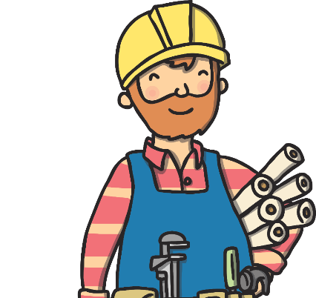

Shelby’s Shoes
?
?
This customer has bought 11 pairs of shoes.
How many shoes has he bought?
?
The product of 11 and 2 is 22.
2
2
2
2
2
2
2
2
2
2
2
0
1
2
3
4
5
6
7
8
9
10
11
12
13
14
15
16
17
18
19
20
21
22
23
24

Slide 21
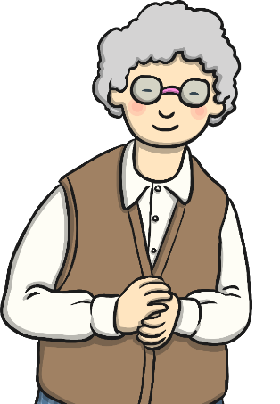
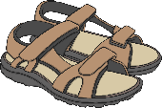
Shelby’s Shoes
?
?
This customer has bought 12 pairs of shoes.
How many shoes has she bought?
?
12 × 2 = 24
2
2
2
2
2
2
2
2
2
2
2
2
0
1
2
3
4
5
6
7
8
9
10
11
12
13
14
15
16
17
18
19
20
21
22
23
24

Slide 22
Patterns
What patterns can you spot?
0 × 2 = 0
1 × 2 = 2
2 × 2 = 4
3 × 2 = 6
4 × 2 = 8
5 × 2 = 10
6 × 2 = 12
7 × 2 = 14
8 × 2 = 16
9 × 2 = 18
10 × 2 = 20
11 × 2 = 22
12 × 2 = 24
The first factor increases by 1 each time.
+ 1
+ 2
+ 1
+ 2
+ 1
+ 2
The second factor in each calculation is 2.
The product increases by two each time.
The products are all even.

Slide 23
Patterns
How can we use the patterns to find the missing numbers?
0 × 2 = 0
1 × 2 = 2
2 × 2 = 4
3 × 2 = 6
4 × 2 = 8
5 × 2 = 10
6 × 2 = 12
7 × 2 = 14
8 × 2 = 16
9 × 2 = 18
10 × 2 = 20
11 × 2 = 22
12 × 2 = 24
+ 2
The product increases by two each time.
4
2 × 2 = 1 × 2 + 2
11 × 2 = 12 × 2 - 2
22
- 2

Slide 24
Practice
Let’s practise the two times tables together.
7 twos are 14.
7 × 2 = 14
1 two is 4.
1 × 2 = 2
8 twos are 16.
8 × 2 = 16
2 twos are 4.
2 × 2 = 4
9 twos are 18.
9 × 2 = 18
3 twos are 6.
3 × 2 = 6
10 twos are 20.
10 × 2 = 20
4 twos are 8.
4 × 2 = 8
11 twos are 22.
11 × 2 = 22
5 twos are 10.
5 × 2 = 10
12 twos are 24.
12 × 2 = 24
6 twos are 12.
6 × 2 = 12
2
2
2
2
2
2
2
2
2
2
2
2
0
1
2
3
4
5
6
7
8
9
10
11
12
13
14
15
16
17
18
19
20
21
22
23
24

Slide 25
2 Times Table Fluency Challenge.
Complete the calculations below. If you can, time how long it takes you.
6 x 2 = | 8 x 2 = | 2 x 1 = | 10 x 2 =
2 x 3 = | 11 x 2 = | 4 x 2 = | 3 x 2 =
2 x 2 = | 2 x 10 = | 9 x 2 = | 0 x 2 =
1 x 2 = | 12 x 2 = | 2 x 5 = | 7 x 2 =
2 x 7 = | 2 x 0 = | 5 x 2 = | 2 x 8 =

Slide 26
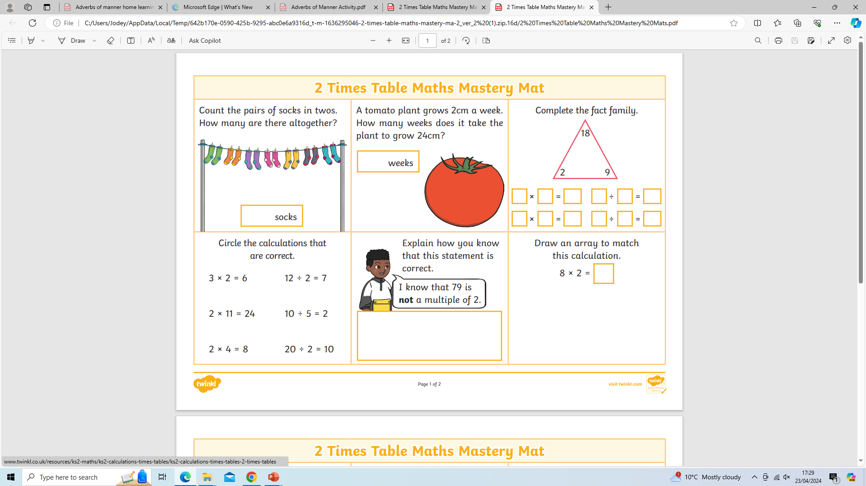

Slide 27
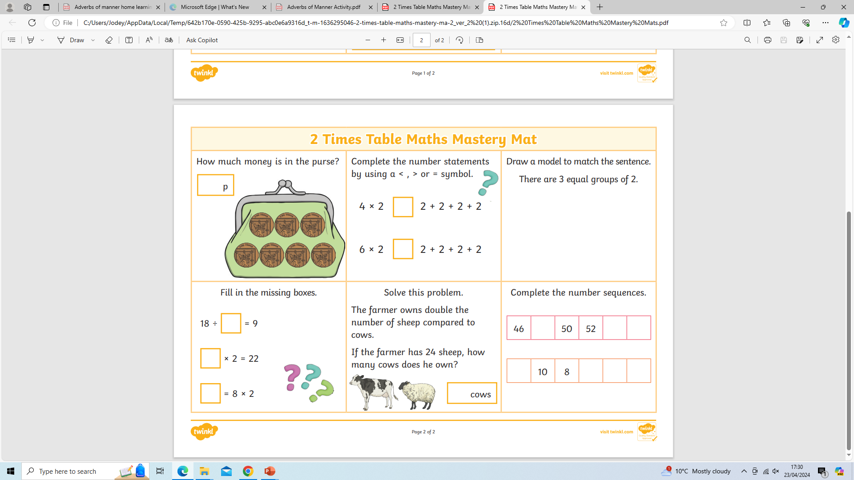

Slide 28
Plenary
Use the greater than, less than and equals symbols to complete these problems. One has been done.
< > =
4 × 2
>
1 × 2 + 2
4 × 2
=
3 × 2 + 2
4 × 2
=
5 × 2 - 2
4 × 2
>
2 × 2 + 2
4 × 2
<
5 × 2 + 2

Slide 29
2 Times Table Fluency Challenge.
6 x 2 = 12 | 8 x 2 = 16 | 2 x 1 = 2 | 10 x 2 = 20
2 x 3 = 6 | 11 x 2 = 22 | 4 x 2 = 8 | 3 x 2 = 6
2 x 2 = 4 | 2 x 10 = 20 | 9 x 2 = 18 | 0 x 2 = 0
1 x 2 = 2 | 12 x 2 = 24 | 2 x 5 = 10 | 7 x 2 = 14
2 x 7 = 14 | 2 x 0 = 0 | 5 x 2 = 10 | 2 x 8 = 16

