Slide 2
Encourage your child to practise their phonics reading with this CVC PowerPoint game.
Phonics is a method used to teach children to learn to read and write by sounding out words by their individual letter sounds, such as sh-e-ll.
Can your child make their own CVC words matching game with the letters they know from Phase 3 Phonics?

Slide 3

Oh no! Felix dropped his paper and some of his phonemes are now missing! Can you help him? You’ll need to decide what the picture shows, then choose the phoneme that’s missing from the examples on each slide.
You’ll need to click the button at the bottom to move to the next slide.
x
Phonemes are the individual sounds that make up a word; when writing those sounds down as letters, they’re called graphemes if they’re 1 letter (like ‘s’), digraphs if they’re 2 letters (like ‘sh’) or trigraphs for 3 letters (like ‘igh’). In phase 3, we’ll have learnt all the graphemes and most of the digraphs and trigraphs! See if you can spot them in this game!
Next slide
Click me!

Slide 4



sh
e
ll
Click the correct phoneme
sh
ch
th
Next slide

Slide 5
qu
ee
n
Click the correct phoneme
ai
ee
i
Next slide

Slide 6

b
o
x
Click the correct phoneme
b
t
x
Next slide

Slide 7

b
u
zz
Click the correct phoneme
zz
ss
x
Next slide

Slide 8

l
u
n
ch
Click the correct phoneme
sh
ch
th
Next slide

Slide 9

f
o
x
Click the correct phoneme
b
r
x
Next slide

Slide 10
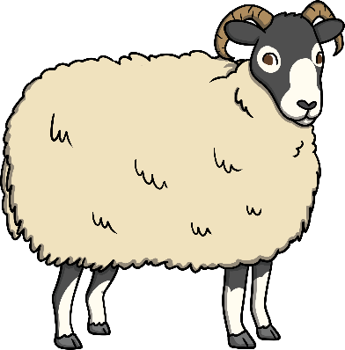
sh
ee
p
Click the correct phoneme
ch
sh
th
Next slide

Slide 11

b
oo
k
s
Click the correct phoneme
ou
o
oo
Next slide

Slide 12

th
or
n
s
Click the correct phoneme
th
f
h
Next slide

Slide 13

c
oi
n
Click the correct phoneme
o
ai
oi
Next slide

Slide 14

b
oo
t
s
Click the correct phoneme
oo
oa
i
Next slide

Slide 15
p
air
Click the correct phoneme
air
ure
er
Next slide

Slide 16

j
o
g
g
er
Click the correct phoneme
er
ur
ar
Next slide

Slide 17

h
air
Click the correct phoneme
er
air
ure
Next slide

Slide 18

m
oo
n
Click the correct phoneme
oi
o
oo
Next slide

Slide 19
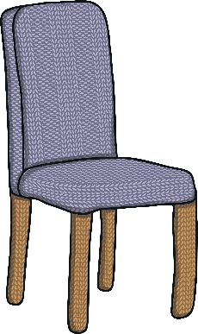
ch
air
Click the correct phoneme
th
sh
ch
Next slide

Slide 20

n
igh
t
Click the correct phoneme
oi
igh
ai
Next slide

Slide 21

b
oi
l
Click the correct phoneme
oi
o
oa
Next slide

Slide 22

m
o
th
Click the correct phoneme
th
sh
ch
Next slide

Slide 23

qu
i
ck
Click the correct phoneme
k
w
qu
Next slide

Slide 24

j
a
m
Click the correct phoneme
j
w
v
Next slide

Slide 25

f
l
ow
er
Click the correct phoneme
o
ow
i
Next slide

Slide 26

c
oa
t
Click the correct phoneme
oa
oi
ai
Next slide

Slide 27

sh
ar
p
Click the correct phoneme
or
ar
ur
Next slide

Slide 28

f
i
sh
Click the correct phoneme
th
ch
sh
Next slide

Slide 29

r
ai
n
Click the correct phoneme
ai
oi
a
Next slide

Slide 30
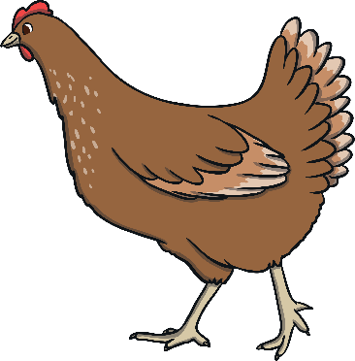
ch
i
ck
e
n
Click the correct phoneme
sh
th
ch
Next slide

Slide 31

f
a
ng
s
Click the correct phoneme
n
ng
g
Next slide

Slide 32

s
ai
l
i
ng
Click the correct phoneme
n
g
ng
Next slide

Slide 33

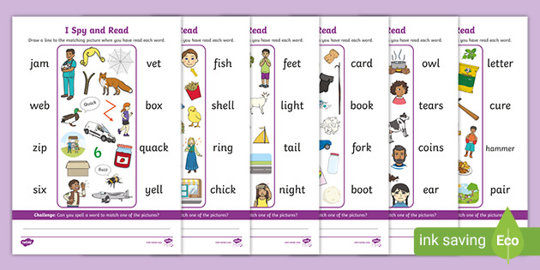
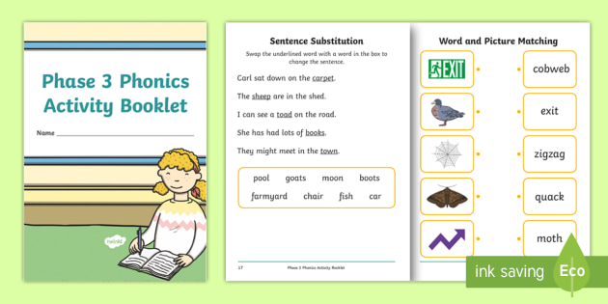
I Spy and Read: Phase 3 Phonics Activity
Phase 3 Phonics Activity Booklet

