Slide 2
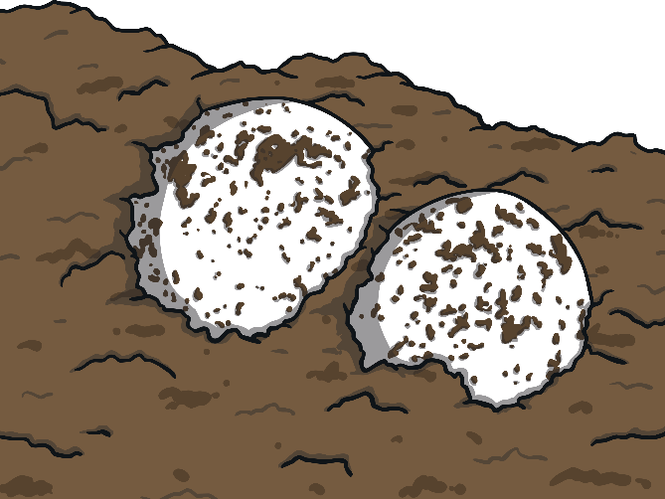
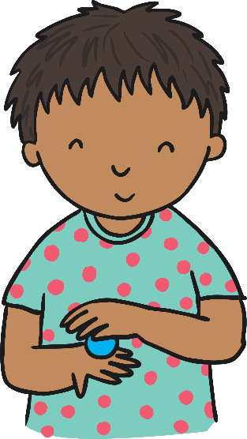
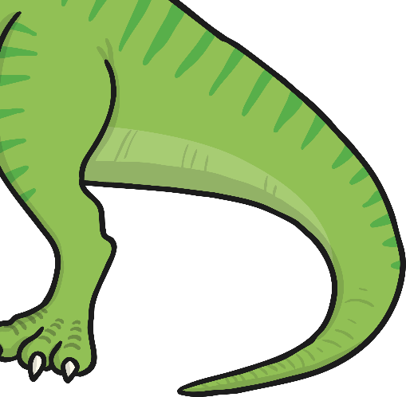
Roll, roll, roll an egg,
Baby dinosaur!
Wobbly, wobbly, wobbly, wobbly,
Like a dinosaur!
Children should roll the playdough
into a ball shape between their hands.

Slide 3
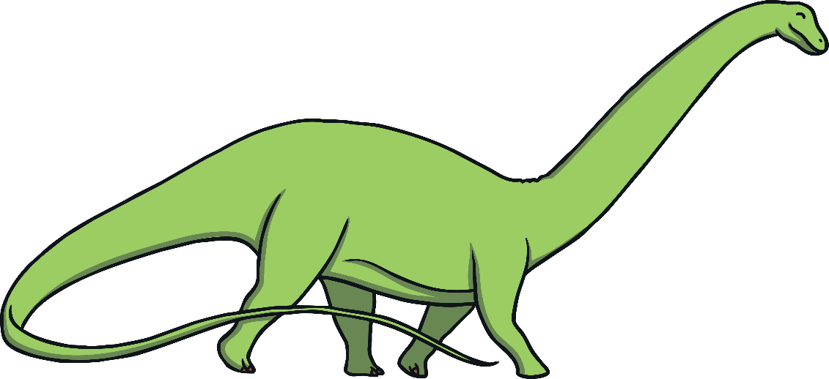
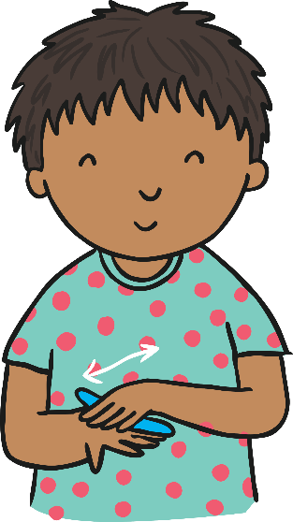
Swish, swish, swish your tail,
Then you swish some more!
Wiggly, wiggly, wiggly, wiggly,
Like a dinosaur!
Children should roll the playdough
into a long sausage shape between their hands.

Slide 4
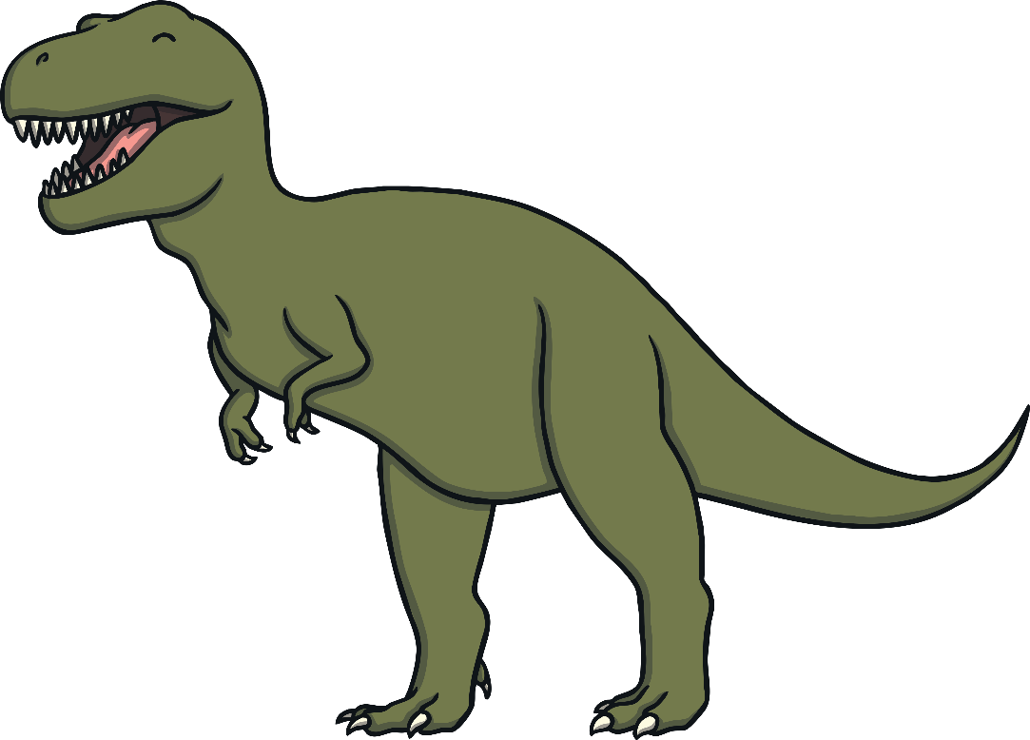
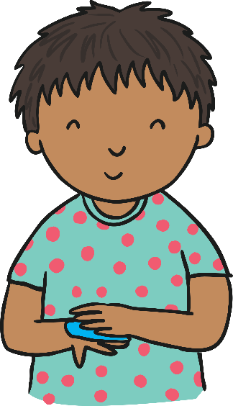
Stomp, stomp, stomp your feet,
Stomp across the floor!
Happily, happily, happily, happily,
Like a dinosaur!
Children should squash the
playdough flat between their hands.

Slide 5

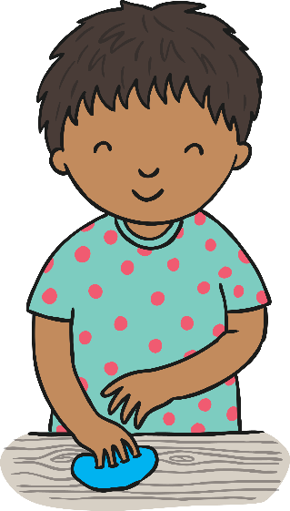
Roar, roar, roar out loud,
Listen to them roar!
Noisily, noisily, noisily, noisily,
Like a dinosaur!
Children should stretch
their fingers in the playdough.

Slide 6
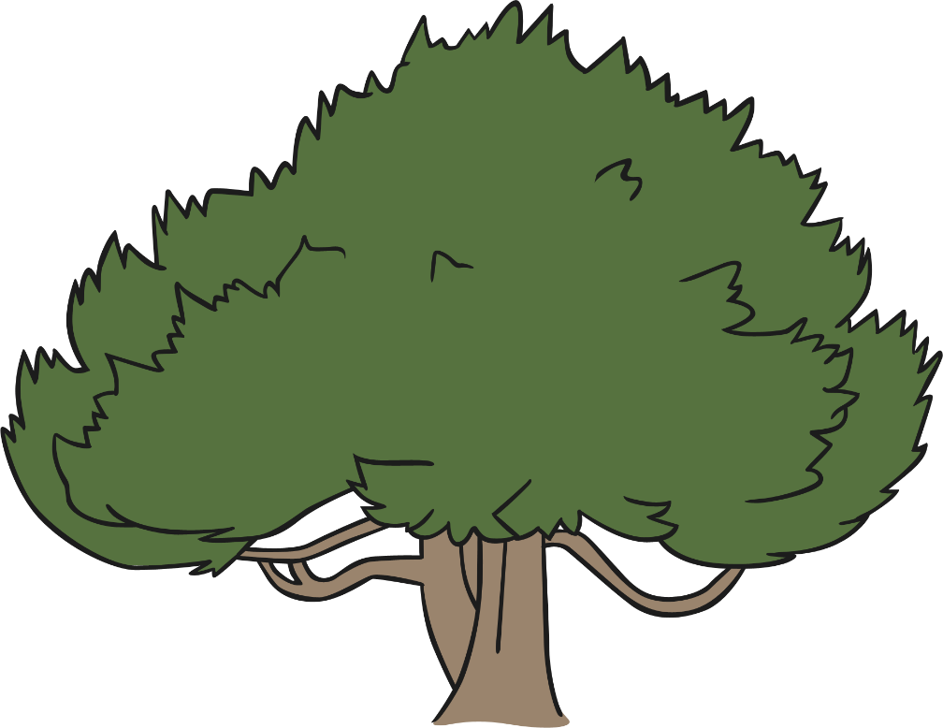
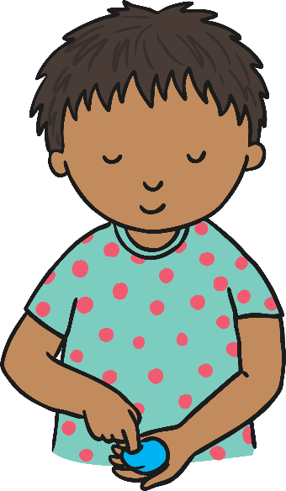

Munch, munch, munch the leaves,
It’s a herbivore!
Hungrily, hungrily, hungrily, hungrily,
Like a dinosaur!
Children should press each finger
into the playdough, one at a time.

Slide 7
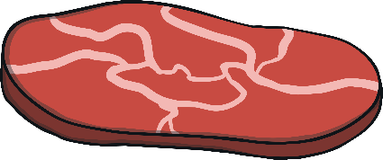

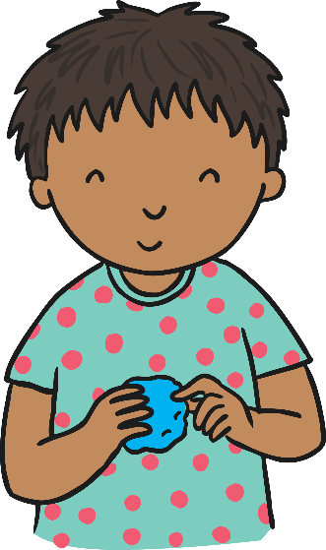
Bite, bite, bite the meat,
It’s a carnivore!
Fiercely, fiercely, fiercely, fiercely,
Like a dinosaur!
Children should pinch the playdough
between their thumb and fingers.

