Slide 2
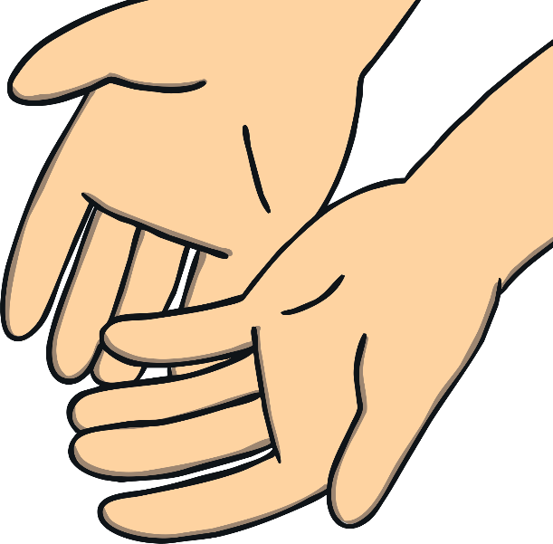
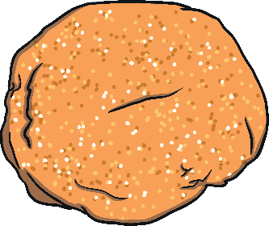
Put your playdough on your hand, on your hand.
Put your playdough on your hand, on your hand.
Take your playdough off your hand, for the song that we have planned.
Take your playdough off your hand, off your hand.

Slide 3

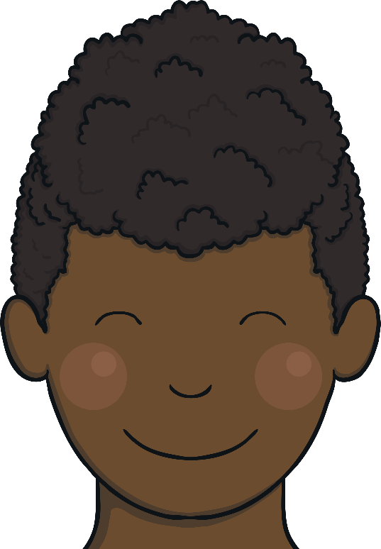
Put your playdough on your head, on your head.
Put your playdough on your head, on your head.
Take your playdough off your head, standing up, look straight ahead.
Take your playdough off your head, off your head.

Slide 4
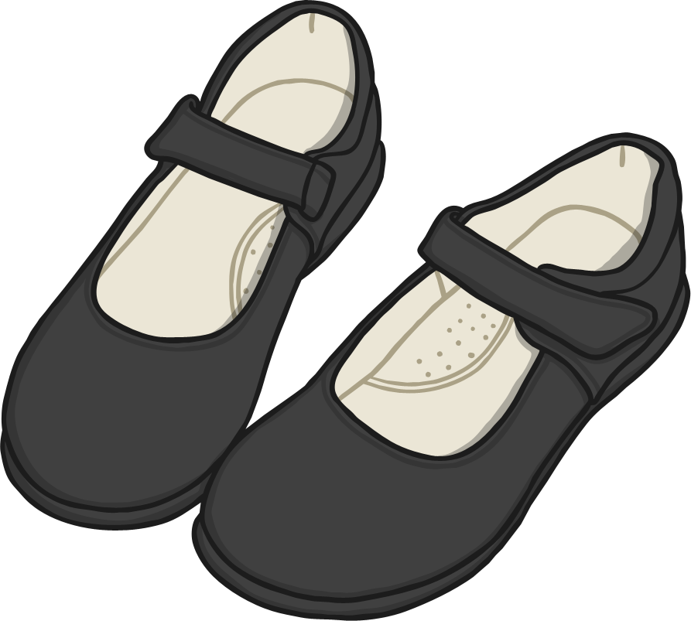
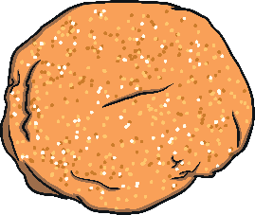
Put your playdough on your shoe, on your shoe.
Put your playdough on your shoe, on your shoe.
Take your playdough off your shoe, get your friend to do it too.
Take your playdough off your shoe, off your shoe.

Slide 5
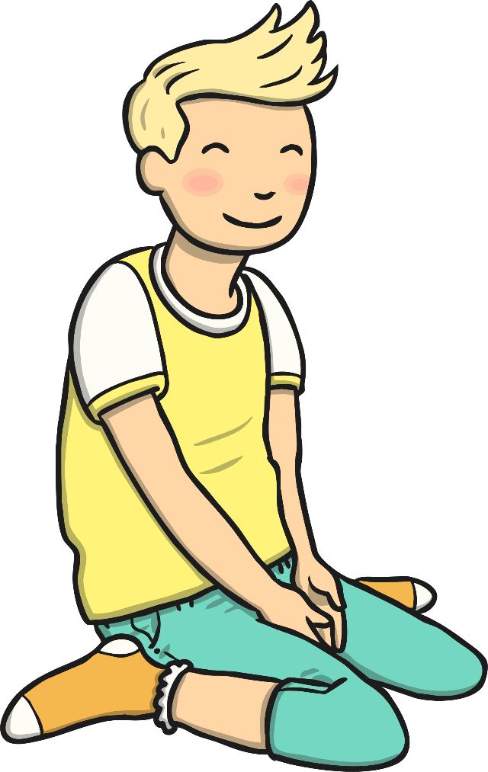
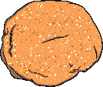
Put your playdough on your knee, on your knee.
Put your playdough on your knee, on your knee.
Take your playdough off your knee, wave it round for us to see.
Take your playdough off your knee, off your knee.

Slide 6
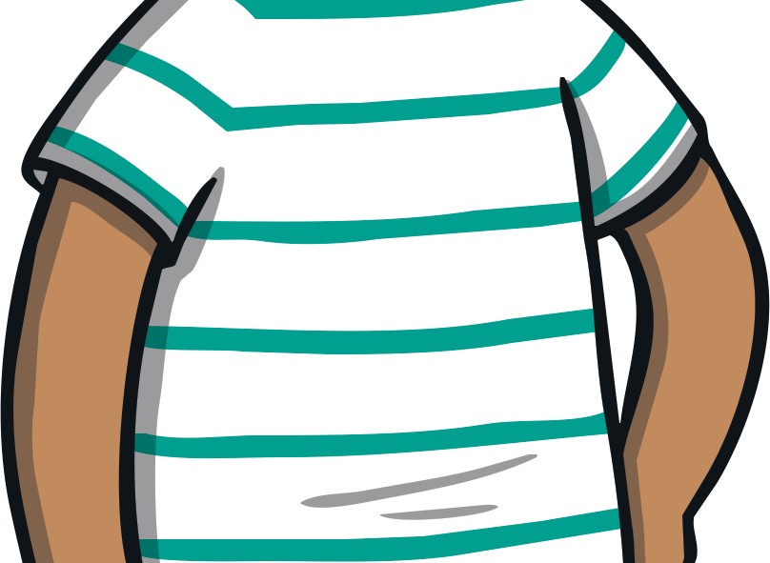

Put your playdough on your tum, on your tum.
Put your playdough on your tum, on your tum.
Take your playdough off your tum, for our song is nearly done.
Take your playdough off your tum, off your tum.

