Slide 1
Algebra SATs Questions
2016-2019

Slide 2
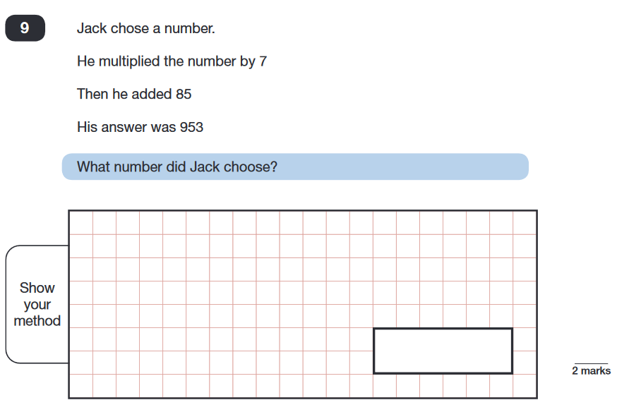

Medium spice

Slide 3
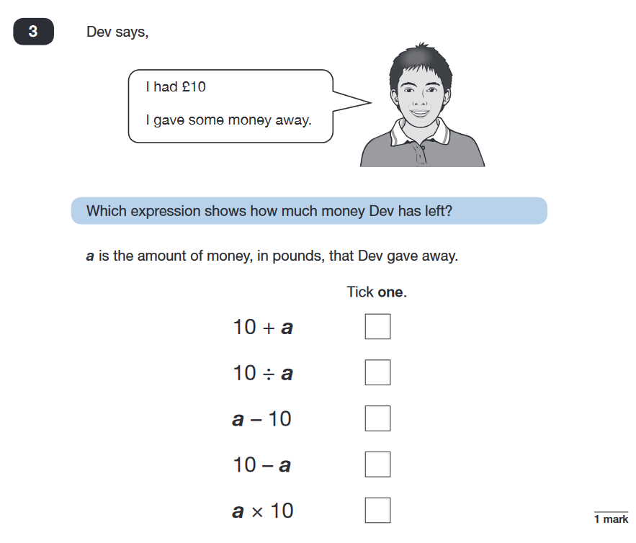
Medium spice

Slide 4
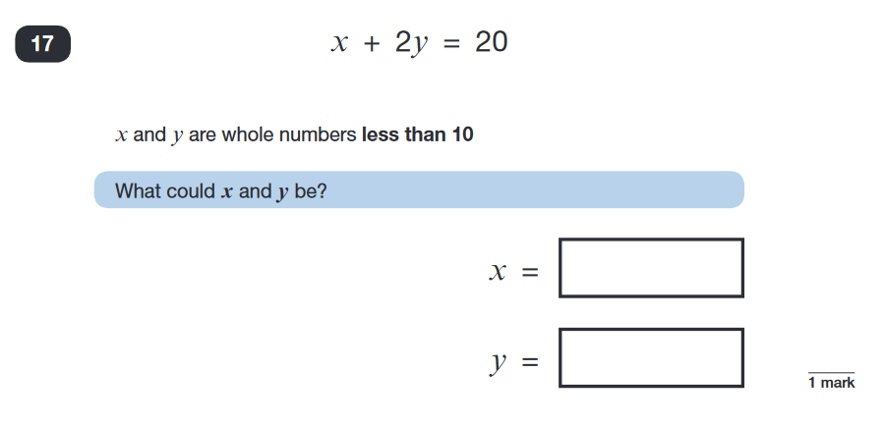
Medium spice

Slide 5
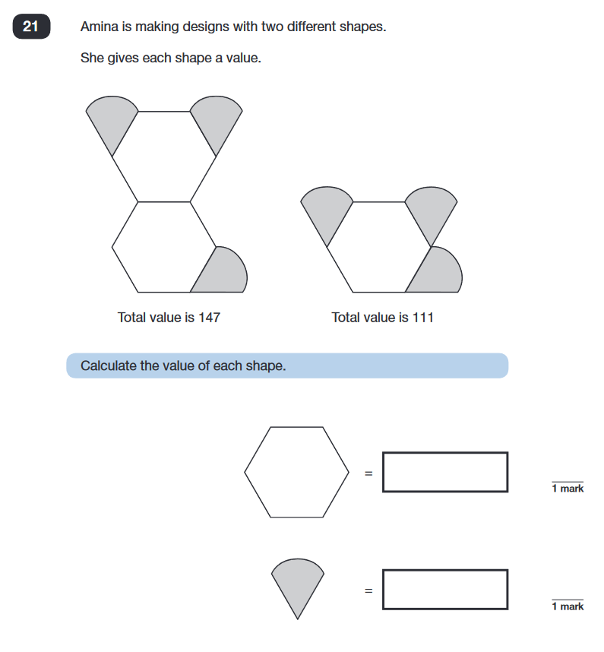
Medium spice

Slide 6
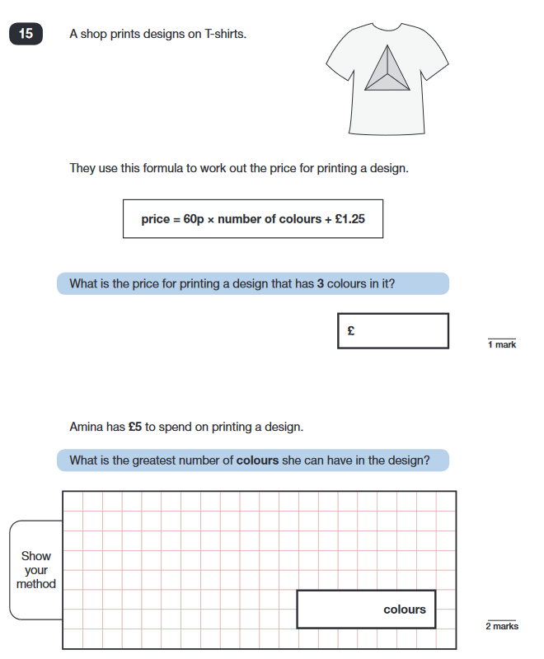
Medium spice

Slide 7
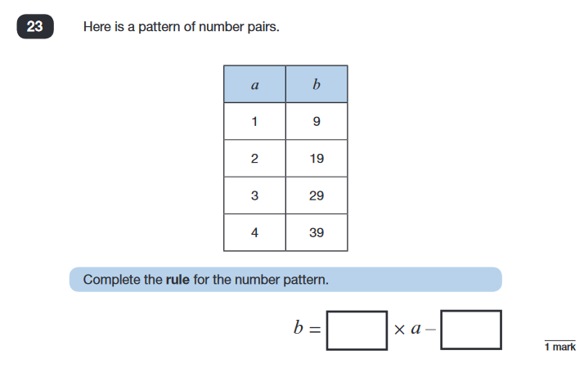
Medium spice

Slide 8
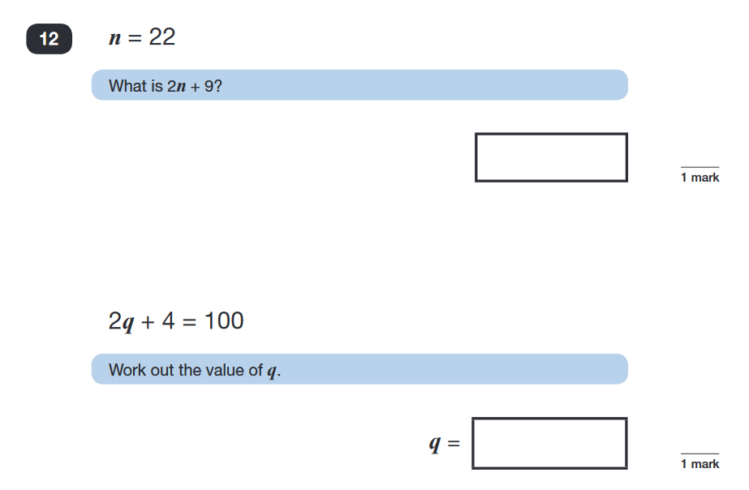
Medium spice

Slide 9
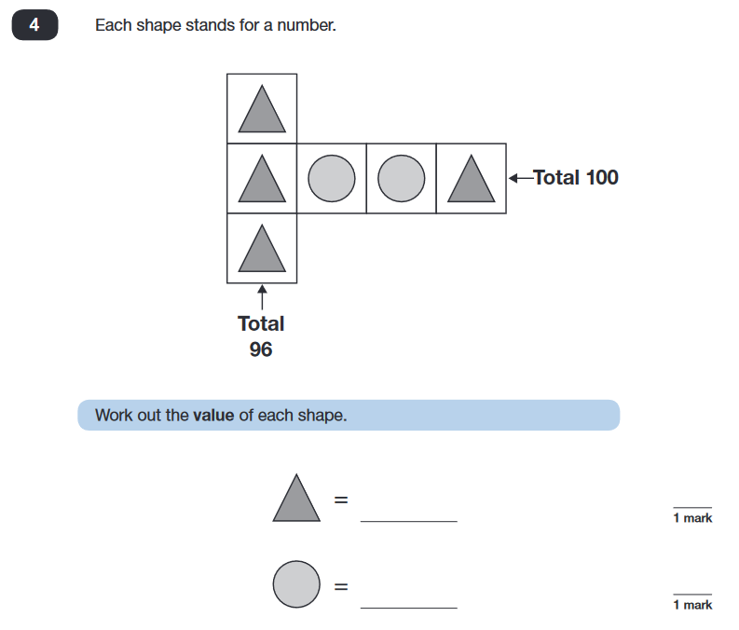

Spicy!

Slide 10
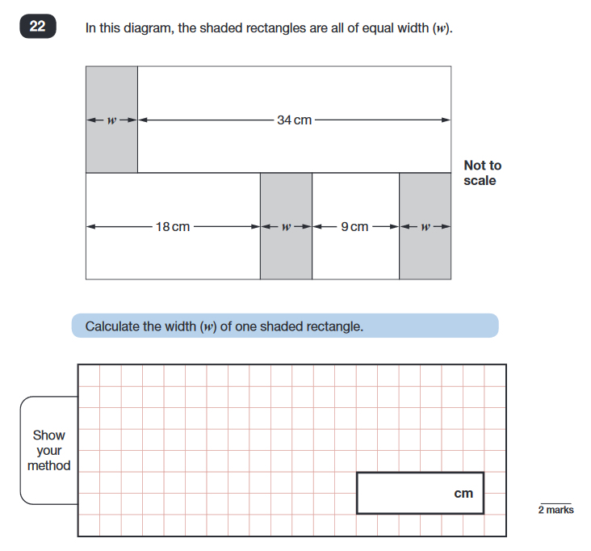
Spicy!

