Slide 1
Date
Arithmetic
Starter
7452 ÷ 5
8534 ÷ 5
1428 ÷ 5
3984 x 5
1832 x 15
4885 x 25

Slide 2
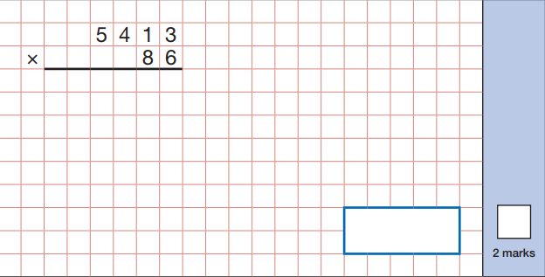
5 4 1 3
x
8 6
3 2 4 7 8
2
1
4 3 3 0 4 0
3
1
2
4 6 5 5 1 8
1

Slide 3
Answer the following questions:
4758 x 19
6473 x 28
9847 x 56
59493 x 43
  Use the method we have just looked at.
  Remember your place holder.
Does it matter which way round you multiply the numbers? Why/ why not? Prove it.

Slide 4
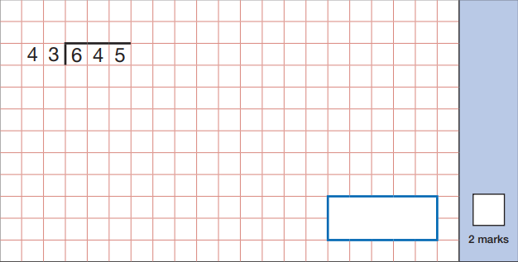
0 1 5
43
6 4 5
6
21
43
86
129
172
215
258
301
344
387

Slide 5
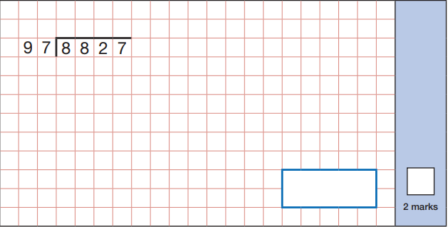
  97, 194, 291, 388, 485, 582, 679, 776, 873
What is the most efficient way of adding 97 each time for your repeated addition? Why?

Slide 6
Answer the following questions:
4758 ÷ 19
6473 ÷ 28
9847 ÷ 56
59493 ÷ 43
  Use the method we have just looked at.
  Remember to try and find the most efficient method for your repeated addition.
Explain why you wouldn’t use the same method for 4568 ÷ 1000

Slide 7
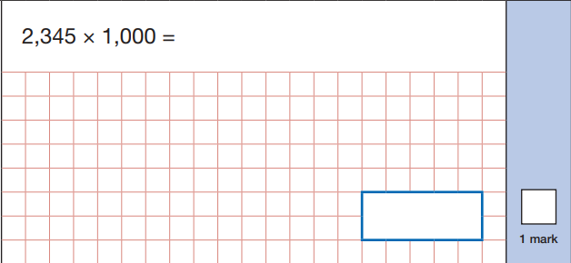
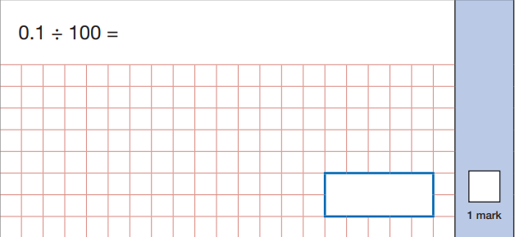

Slide 8
Answer the following questions:
4758 ÷ 10
6.473 x 100
9847 ÷ 1000
594.93 x 10
Explain why you can’t always just add a zero on the end when multiplying by 10, 100 or 1000
  Use the methods we have just looked at.

Slide 9
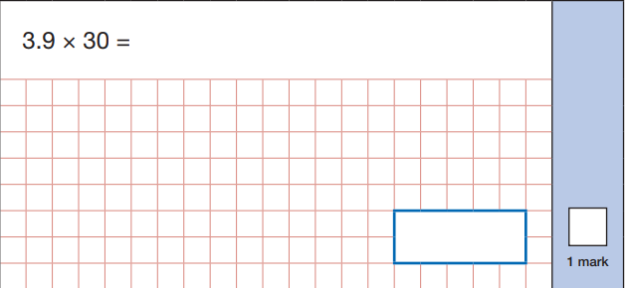
3.9 x 10 = 39
39 x 3 = 117
3.9 x 3 = 11.7
11.7 x 10 = 117

Slide 10
Answer the following questions:
4.6 x 20
0.7 x 50
9.6 x 70
12.3 x 40
0.9 x 400
Why can you use a different method for the second and fifth question?
  Use the methods we have just looked at or your own method.

Slide 11
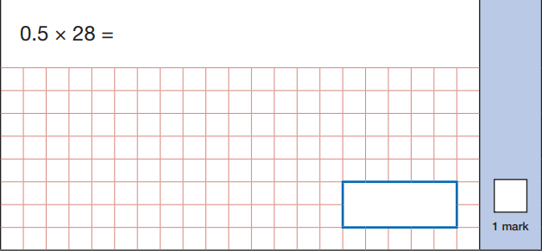
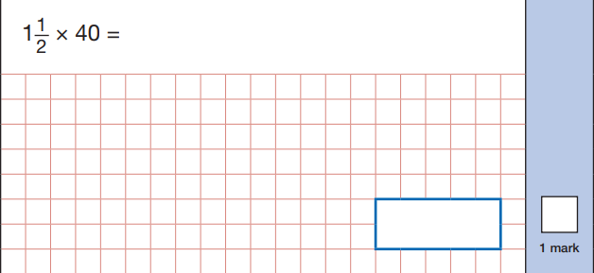
½ of 28 = 14
1 x 40 = 40
½ of 40 = 20
40 + 20 = 60

Slide 12
Answer the following questions:
54 x 0.5
1 ½ x 76
48 x 0.5
98 x 2 ½
60 x 0.25
Why can you use a different method for the second and fifth question?
  Use the methods we have just looked at or your own method.

Slide 13
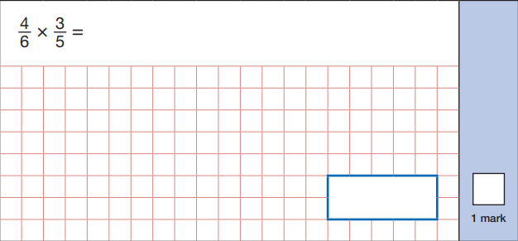






$$\frac{4}{6}$$
$$\frac{3}{5}$$
x
4 x 3 = 12
6 x 5 = 30
$$\frac{4}{6}$$
$$\frac{3}{5}$$
$$\frac{12}{30}$$
$$\frac{2}{5}$$
x
=
=

Slide 14








Answer the following questions:
$$\frac{2}{3}$$
$$\frac{4}{7}$$
$$\frac{1}{4}$$
$$\frac{3}{10}$$
x
x
$$\frac{5}{9}$$
$$\frac{3}{5}$$
$$\frac{12}{15}$$
$$\frac{21}{30}$$
x
x
Which ones can you simplify? How do you know?
  Numerator x numerator
  Denominator x denominator

Slide 15
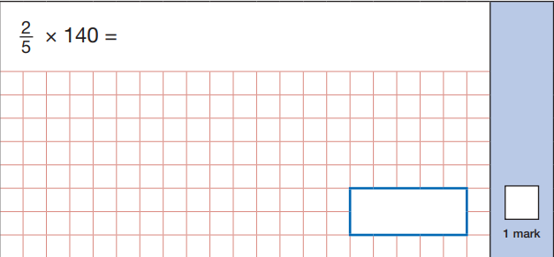


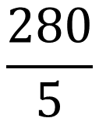
$$\frac{2}{5}$$
x 140
2 x 140 = 280
$$\frac{2}{5}$$
$$\frac{280}{5}$$
x 140
=
280 ÷ 5 = 56

Slide 16




Answer the following questions:
$$\frac{2}{5}$$
$$\frac{1}{4}$$
x 400
x 400
$$\frac{5}{10}$$
$$\frac{2}{5}$$
x 320
x 180
How else could you solve the second question? Why?
  Whole number x numerator

Slide 17
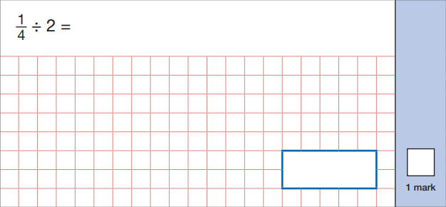



$$\frac{1}{4}$$
÷ 2
4 x 2 = 8
$$\frac{1}{4}$$
÷ 2
$$\frac{1}{8}$$
=

Slide 18
Answer the following questions:
$$\frac{2}{3}$$
$$\frac{1}{4}$$
÷ 4
÷ 3
$$\frac{5}{9}$$
$$\frac{12}{15}$$
÷ 6
÷ 4
How else could you solve the final question? Why?
  Whole number x denominator

Slide 19
Answer the following questions:
3848 x 7
5883 x 19
4749 x 84
49390 x 68
748.49 x 1000
3.53 x 10
3848 ÷ 7
5883 ÷ 19
4749 ÷ 84
49390 ÷ 68
748.49 ÷ 1000
3.53 ÷ 10

