Slide 1
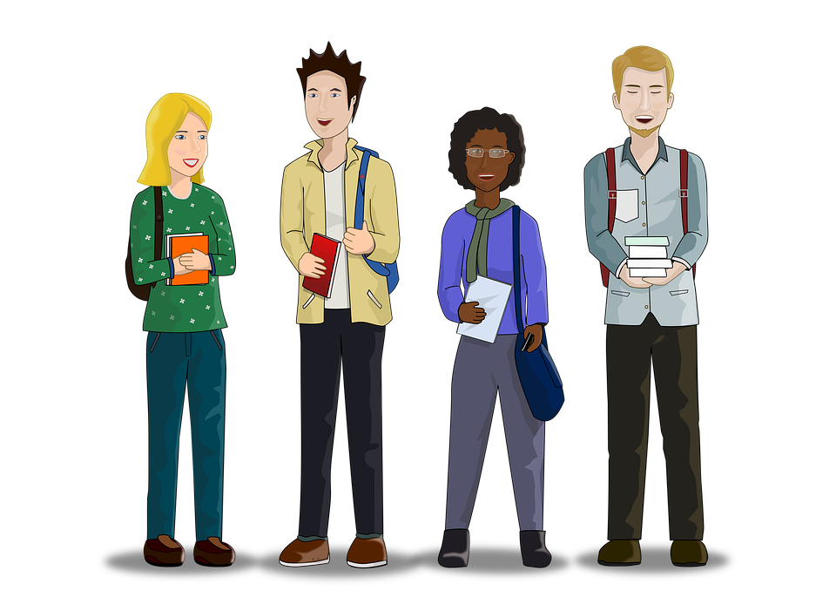
MATHS SATS SUPERSTARS
REVISION GUIDE AND QUIZ
RATIO AND PROPORTION

Slide 2
Solve problems involving ratio
Solve problems involving proportion
Solve problems involving calculating percentages
Solve problems involving scale factors

Slide 3
Revise
Solve problems involving ratio
Ratio compares the parts of a total amount.
The total amount could get smaller or larger, but the relationships between the parts stays the same.
There are 10 counters in a bag. The ratio of red to blue is 4:6.
The ratio of red marbles
The ratio of blue marbles
The total amount
Just like fractions, ratios can be simplified by dividing by a common factor.
4:6 both have a common factor of 2 and can be simplified to 2:3.

Slide 4


Revise
Solve problems involving ratio
There are 36 pieces of fruit in a box.
If the ratio of apples to oranges is 4:5, how many bananas are there?
Divide the total amount by the total of all the parts in the ratio to find the value of one part:
36 ÷ (4 + 5) = 36 ÷ 9 = 4
2. Multiply each ratio by the value of one part.
 | Apples | Bananas
Ratio | 4 | 5
Amount | 4 × 4 = 16 | 5 × 4 = 20
You will notice that when you add the parts back together, they make the total amount:
16 + 20 = 36

Slide 5
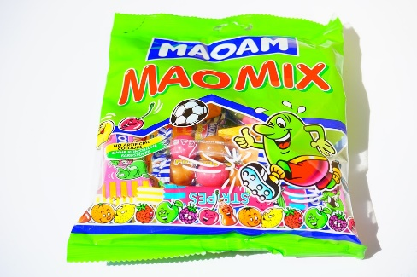
Quiz
Solve problems involving ratio
In a bag of sweets, the ratio of red to green sweets is 7:5. If there are 252 sweets in the bag altogether, how many green sweets are there?
105 green sweets
75 green sweets
45 green sweets
105 green sweets
Try again!
Correct!

Slide 6
Quiz
Solve problems involving ratio
How many more squares need to be shaded to make the ratio of shaded to unshaded squares 3:2?
4 squares
2 squares
3 squares
3 squares
Try again!
Correct!

Slide 7
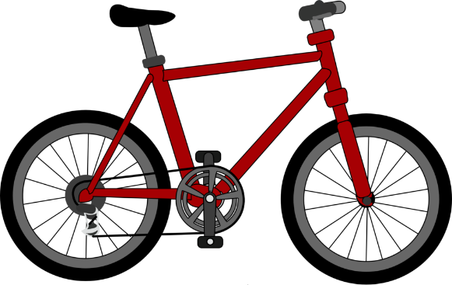
Quiz
Solve problems involving ratio
In a class of 24 children, 8 children can ride a bike. What is the ratio of bike riders to non-bike riders?
8:24
2:1
4:2
2:1
Try again!
Correct!

Slide 8

Quiz
Solve problems involving ratio
Ameila and Ethan share out £216 using the ratio 3:5. How much money does Amelia receive?
£81
£135
£27
£81
Correct!
Try again!

Slide 9
Quiz
Solve problems involving ratio
There are 45 counters in a bag. The ratio of red to blue to green counters is 1:2:6. How many green counters are there?
10 counters
30 counters
9 counters
30 counters
Try again!
Correct!

Slide 10

Quiz
Solve problems involving ratio
A recipe for a fruit smoothie says to use apples and strawberries in the ratio 2:5. If I use 6 apples, how many strawberries should I use?
15 strawberries
12 strawberries
15 strawberries
10 strawberries
Choose another objective
Try again!
Correct!

Slide 11

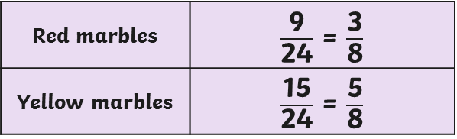
Revise
Solve problems involving proportion
Proportion describes parts of a whole.
There are 24 marbles in a jar.
There are 9 green marbles and 15 yellow marbles.
We can describe the proportions of the colours of the marbles using fractions, simplifying where necessary.
Remember, ratio is different to proportion as ratio compares the parts of a total amount.
The ratio of green marbles to yellow marbles is:
9:15
This can also be simplified to:
3:5
Green marbles
Yellow marbles

Slide 12
Quiz
Solve problems involving proportion
What is the proportion of shaded squares in this pattern?
8 in 27
8 in 19
27 in 8
8 in 27
Try again!
Correct!

Slide 13
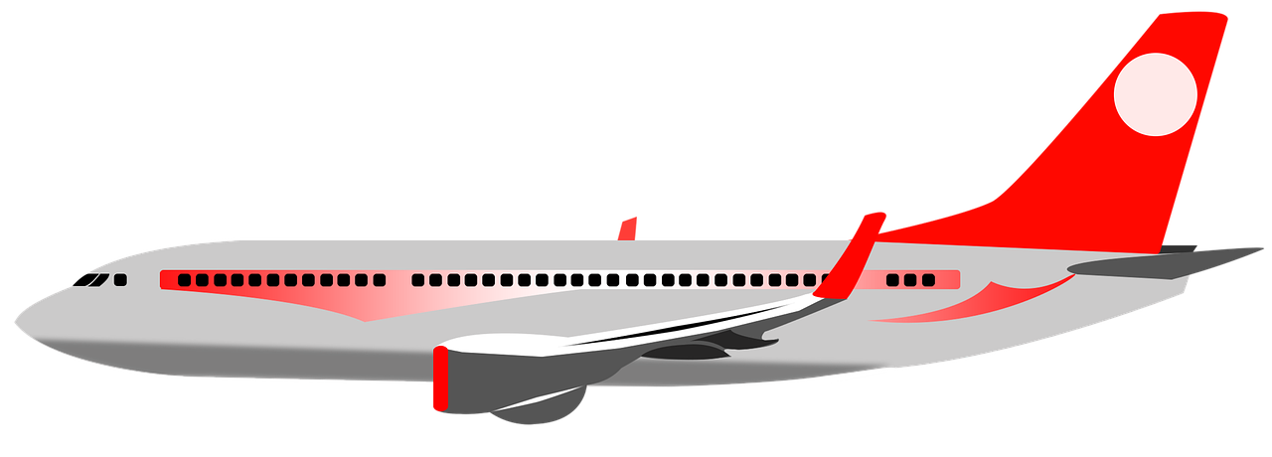




Quiz
Solve problems involving proportion
In a class of 36 children, 7 children have been on holiday to Asia. What proportion of the class have been to Asia?
$$\frac{7}{36}$$
$$\frac{4}{36}$$
$$\frac{1}{4}$$
$$\frac{7}{36}$$
Try again!
Correct!

Slide 14





Quiz
Solve problems involving proportion
A recipe says to use cranberries and sultanas in the ratio 3:7. What is the proportion of sultanas in this recipe?
$$\frac{3}{10}$$
$$\frac{7}{3}$$
$$\frac{7}{10}$$
$$\frac{7}{10}$$
Try again!
Correct!

Slide 15

Quiz
Solve problems involving proportion
Out of the 240 students in GCSE classes, 3 in every 8 students cycle to college. This is half of the proportion of the A Level students. If there are 180 A-Level students, how many A-Level students cycle to college.?
120 students
180 students
135 children
135 students
Choose another objective
Try again!
Correct!

Slide 16
Revise
Solve problems involving calculating percentages
Calculating percentages of an amount
Find 34% of £150 Remember that to find 10% of any number, we can use place value understanding to divide by 10. £150 ÷ 10 = £15 so 10% of £150 = £15 Multiply 10% of the amount by 3 to find 30%. £15 × 3 = £45 so 30% of £150 = £45 Remember that to find 1% of any number, we can use a place value understanding to divide by 100. £150 ÷ 100 = £1.50 so 1% of £150 = £1.50 Multiply 1% of the amount by 4 to find 4%. £1.50 × 4 = £6 so 4% of £150 = £6 Add the value of 30% and 4% together to find the answer. £45 + £6 = £51 34% of £150 = £51 Can you find the same percentage using a different method?

Slide 17
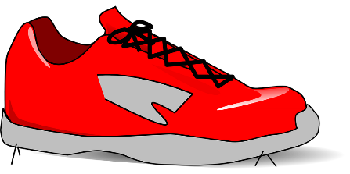
Revise
Solve problems involving calculating percentages
Calculating percentage decreases
A pair of trainers costing £75 are reduced by 22% in a sale. What is the new price? First, calculate 22% of £75. You could use blocks of 10% and 1%. 10% = £75 ÷ 10 = £7.50 20% = £7.50 × 2 = £15 1% = £75 ÷100 = £0.75 2% = £0.75 × 2 = £1.50 22% = £15 + £1.50 = £16.50 Subtract 22% from the original price to find the reduced price. £75 - £16.50 = £58.50 The sale price of the trainers is £58.50.
22% off!

Slide 18

Revise
Solve problems involving calculating percentages
Calculating percentage increases
A monthly contract for a smart phone is increased by 9% from £30. What is the new price of the contract? First calculate 9% of £30. You could use blocks of 10% and 1%. 10% of £30 = £30 ÷ 10 = £3 1% of £30 = £30 ÷100 = £0.30 9% of £30 = £3 - £0.30 = £2.70 Add 9% to the original price to find the increased price. £30 + £2.70 = £32.70 The increased price of the contract is £32.70.

Slide 19
Quiz
Solve problems involving calculating percentages
A pair of trainers costs £45.50. In the sale they have 10% off. What is the sale price?
£40.95
£41.59
£42.56
£40.95
Try again!
Correct!

Slide 20
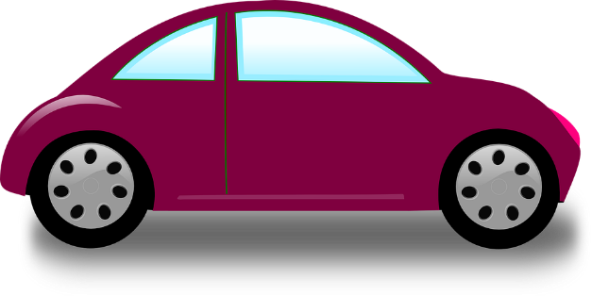
Quiz
Solve problems involving calculating percentages
1460 people visit the shopping centre during one day. 45% of the visitors parked in the car park. How many visitors did not park in the car park?
803 visitors
657 visitors
803 visitors
680 visitors
Try again!
Correct!

Slide 21

Quiz
Solve problems involving calculating percentages
John works at the local petrol station on a Saturday. He earns £28.40. His wages increase by 25%. How much does he earn now?
£35.50
£35.50
£21.30
£34.50
Try again!
Correct!

Slide 22

Quiz
Solve problems involving calculating percentages
The price of a coffee is £2.20. The price is reduced by 15% if you use a reusable cup. What is the new price of the coffee?
£1.78
£1.98
£1.87
£1.87
Choose another objective
Try again!
Correct!

Slide 23
Revise
Solve problems involving scale factors
Scaling is when you reduce or enlarge dimensions proportionally.
Scaling is commonly used in maps, building plans and models, and is described as a ratio called scale factor.
The length of square A is 2.
The length of square B is 4.
×2
A
The width of square A is 2.
The width of square B is 4.
B
×2
Square B is an enlargement of square A using a scale factor of 2.

Slide 24
Revise
Solve problems involving scale factors
A model car has a scale factor of 1:15.
The length of the model car is 25cm.
What is the length of the full-size car?
Using the scale factor, we can see that the dimensions of the full size car are 15 times larger than the model.
Use a written method to multiply 25cm by 15.
25 × 15 = 375cm = 3.75m

Slide 25
Quiz
Solve problems involving scale factors
Enlarge this square by a scale factor of 3.
Correct!
Try again!

Slide 26
Quiz
Solve problems involving scale factors
What is the correct reduction of this rectangle using a scale factor of 0.5?
Try again!
Correct!

Slide 27
Quiz
Solve problems involving scale factors
What is the new measurement of the side of this triangle if it is enlarged using a scale factor of 2.5?
4cm
10cm
6.5cm
9cm
10cm
Try again!
Correct!

Slide 28
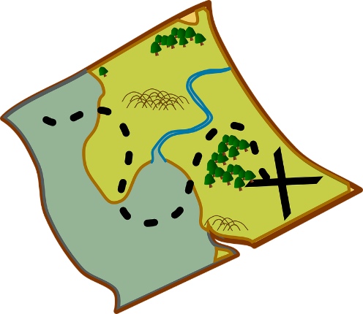
Quiz
Solve problems involving scale factors
On a 1cm : 25 000cm scale map, a distance is measured as being 20cm. How far would this actually be in kilometres?
5km
7.5km
5km
10km
Try again!
Correct!

Slide 29
Quiz
Solve problems involving scale factors
A square with sides of 4cm is enlarged. What was the scale factor if the sides of the enlarged square measure 14cm?
Scale factor of 10
Scale factor of 3.5
Scale factor of 3
Scale factor of 3.5
Choose another objective
Try again!
Correct!

